Slide 1
#Jahee
WP2 – State of the art
What we have done
What we are working on
Notes:
Raise profile
Follow us

Slide 2
communication
Dissemination
in close collaboration with WP1 and all WPs
Some activities are carried on with the support of Eurohealthnet
(external service provider – WP2 and 4
Notes:
Inform, engage, promote
Two sides of the same medal
Both C and D focus on
1) To promote and communicate on project's objectives and results during the lifetime of the action
2.To effectively sustain the project's results beyond the project duration
= to make accessible to and usable by different stakeholders the project achievements
= to reach the widest possible scale of implementation after the end of the project and therefore,
= to maximise the IMPACT of the project

Slide 3
WP2 objectives and tasks
General objectives
To guarantee a well co-ordinated communication in each stage of the JA
To maximise the dissemination of JAHEE efforts and results
WP2 Tasks
JAHEE visual identity OK
Reference terminology (glossary) OK
Stakeholder analysis in progress
Dissemination channels and networks in progress
Communication and Dissemination Strategy OK
Communication tools in progress
Dissemination monitoring in progress
Advocacy in progress
partial support of external service provider
partial support of
external service provider
support of external service provider
Notes:
WHY IS DISSEMINATION IMPORTANT?
1.To promote and communicate on project's objectives and results during the lifetime of the action
2.To effectively sustain the project's results beyond the project duration
= to make accessible to and usable by different stakeholders the project achievements
= to reach the widest possible scale of implementation after the end of the project and therefore,
= to maximise the IMPACT of the project

Slide 4
Quick overview
Notes:
Raise profile
Follow us

Slide 5


JAHEE VISUAL IDENTITY
Logo, colours, font, graphics, style, etc.
To be used for all
JAHEE communication and dissemination material
Look and Feel JAHEE
Logo and Templates for reports and for presentations
available on WRIKE platform

Slide 6

COMMUNICATION & DISSEMINATION PLAN
the pillar of WP2 activity
WP 2 DELIVERABLE 2.2
Objective:
to meet communication and dissemination requirements of
  JAHEE participants
  JAHEE stakeholders

Slide 7

COMMUNICATION & DISSEMINATION PLAN
In brief, in Annex 5
WP 2 DELIVERABLE 2.2 – Annex 5
Quick reference Guide

Slide 8
COMMUNICATION
AND DISSEMINATION TOOLS
State of the art
JAHEE Leaflets, posters, bookmarks done
JAHEE Power point template for presentations done – can be adapted
Power point «JAHEE in brief» done – can be adapted
Twitter account active
Video interviews done, others to be added
Project website done
STAKEHOLDER ANALYSIS started
ALL IN WRIKE PLATFORM

Slide 9

JAHEE POWER POINT PRESENTATION
JAHEE in brief
13 basic slides
to introduce JAHEE
aims and objectives, participants, WPs and contacts,
general information,
approach, governing structure
You can translate it in your native language, add more slides
You can adapt it according to your requirements
Eg, present more details on your WP, your country, delete slides, etc
It will be sent by e-mail and made available on JAHEE website
in English and other languages

Slide 10

JAHEE LEAFLET
Few copies printed
in English and Italian
8 pages
mainly for dissemination at events
Similar information
as the power point presentation
You can reprint it, and translate it
if you need

Slide 11

MULTIMEDIA COMMUNICATION
Video interviews and pictures
To document important meetings (Kick off and others) on the website
Remember to get permissions signed for JAHEE dissemination
Notes:
Scheme of the video interview
Content: WP leaders and selected speakers will express their views on the project by answering the one of the following questions
What is the major value of this Joint Action? Why do you think the Joint action is important? What is the biggest challenge? What is your specific commitment in the project? What is the value for your country?
Duration: 2 minutes
Language: English or native language with translation provided by speaker afterwards

Slide 12
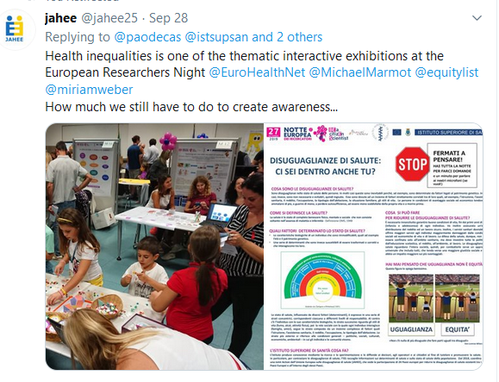


TWITTER ACCOUNT
Health Inequalities at the European researchers night, September 27, 2019,
Engaging about 2000 visitors at ISS

Slide 13

JAHEE GLOSSARY
Reference terminology
Over 100 terms
All supported by references
Published: February 2019
Updated: August 2019
Notes:
Over 100 terms

Slide 14
STAKEHOLDER ANALYSIS
In progress
Initial questions
Who could directly benefit from the project results?
Who could further implement the project results at EU and MS (national and regional) level (policy makers, health and non health ministries?
Who could oppose to the project results?
Two stages
Survey among partners→ creation of networks (updated regularly)
Awareness among traditional and “non converted” stakeholders
2) Stakeholders mapping at EU, national, regional and local level
- relevant departments and individuals;
- formal and informal working groups;
- interest groups/non-governmental organizations (NGOs)
Notes:
Task 2.3 Stakeholders analysis (This task will be provided by an external service provider)
At the beginning of the JA WP2 will conduct a survey among partners to identify a broad range of stakeholders from different policy sectors in order to facilitate targeted dissemination, communication activities and the creation of networks. A regular updating of the survey results should be envisaged. The aim is to ensure wide awareness of the JA both within the traditional public health sphere and amongst ‘non-converted’ stakeholders such as ministries of finance, social welfare, employment and environment, as well as other relevant stakeholders. The stakeholders identification will be vertical (looking at individuals and organizations working in relevant fields from European to national, regional, and local level) and horizontal, mapping stakeholders in related fields but who do not have a public health focus. Stakeholders will be sorted according ability to influence and interest. A database of JA contacts and mailing lists will be created.
Phase one – identification of:
• government sectors related to the JA working areas per MSs and their competencies;
• identification of the ‘non-converted’ stakeholders and their needs and preferences.
Phase two – mapping, at EU, national, regional and local level, of:
• relevant departments and individuals;
• formal and informal working groups;
• interest groups / Non-governmental organizations (NGOs)

Slide 15

a template that we designed to carry out our stakeholder mapping and subsequent analysis (see JAHEE deliverable 2.2). This exercise is crucial to ensure that a wide range of stakeholders are aware of and engaged in the JA. A database of JA contacts and mailing lists will be created and made available on the Wrike platform.
Given your knowledge of your own national context, we kindly invite you to support us in this exercise by indicating those stakeholders that you consider relevant for the JA.
Enclosed you can find a spreadsheet with a number of fields to fill in. We hope to receive at least 10 stakeholders from each of you.
STAKEHOLDER MAPPING
It is crucial to ensure that a wide range of stakeholders are aware of
and engaged in the JA.
A template was designed to carry out stakeholder mapping
Objective
a database of precious contacts and mailing lists
available in Wrike platform
You will receive a template to collect info on stakeholders
that you consider relevant for JAHEE (at least 10)
Name
Position
Department
Organization
Type of organization
Area of interest
Country
E mail
Website
Notes:
1. Fill in the fields with the information that you have available. Missing information can be added in later stages through desk research.
2. When possible, indicate the level of interest and level of influence based on your knowledge.
a. The level of interest indicates at what degree an organisation prioritises or actively supports health equity, social inclusion and/or social determinants of health.
b. The level of influence indicates the degree in which an organisation can impact the policy making process and/or the public debate.
3. We invite you to add both individuals or organisations to the excel, as you find appropriate
4. Should a stakeholder hold a position in more than one organisation, please indicate the most relevant for this mapping and leave a comment referring to the other positions.
5. Emails should be provided only if publicly available.
6. Please avoid the use of acronyms.
7. To facilitate later analysis, the table is locked. You are only able to edit the content of the table.
8. Should you wish to consult the list of “organisation types” and “areas of interests”, please consult click on the sheet “dropdown lists” at the bottom of the document.
With kind regards,
Paola De Castro (WP2 Leader) and Raffaella Bucciardini (Coordinator)

Slide 16
STAKEHOLDER ANALYSIS
Your input is essential!
To complete the survey
Partners will receive an e-mail including
the template to contribute to the stakeholder mapping
(with national stakeholders)
Instructions
Deadlines ______

Slide 17
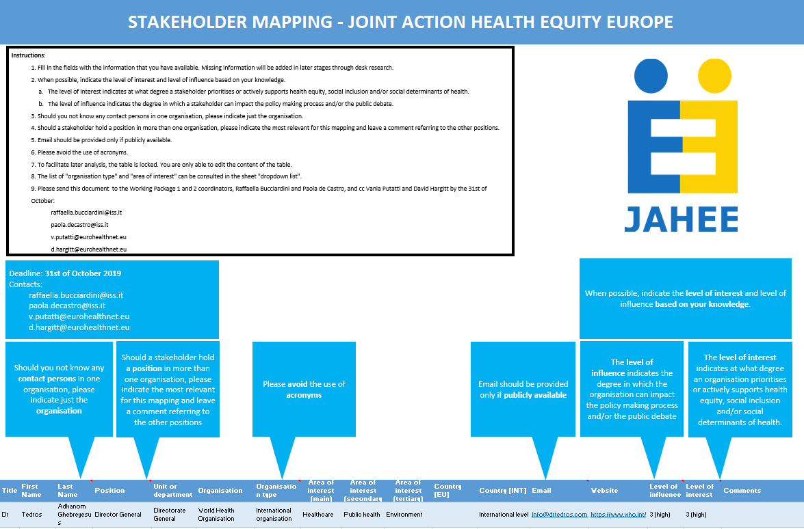

Slide 18
DISSEMINATION ACTIVITY
Dissemination report
To be released soon
Based on
main results of a questionnaire which was shared with JAHEE partners from the 23rd July 2019 to the 24th August 2019
In brief
All WPs have participated in dissemination activities.
Nearly half (46%) of the reported dissemination activities
had a horizontal scope in the promotion of JAHEE.
WP 9 (10%) and WP 5 (16%) reported the most WP specific dissemination activities.
Activities included 48 events in 17 different countries, conferences or other meetings, 14 publications and others (14).
Dissemination has been carried out in 14 different languages.

Slide 19
DISSEMINATION ACTIVITY
Focus of dissemination
Horizontal: 46%
WP Specific: 54%

Slide 20
DISSEMINATION ACTIVITY
Type of dissemination

Slide 21
DISSEMINATION ACTIVITY
Number of events per country

Slide 22



EXAMPLES OF DISSEMINATION
AND ADVOCACY ACTIVITY
Any meeting is an oppotunity for advocacy…
Conventions
Newsletters
Conferences

Slide 23
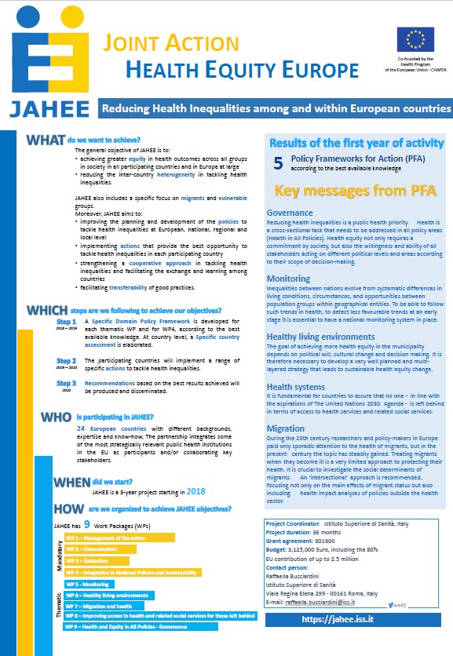
Poster prepared for
EU Health Programme Conference
(Sept, 2019)
It is generic, so you can use/adapt it!
It will be in wrike

Slide 24

EXAMPLES OF DISSEMINATION
AND ADVOCACY ACTIVITY
Taken from the dissemination report
(available shortly)

Slide 25
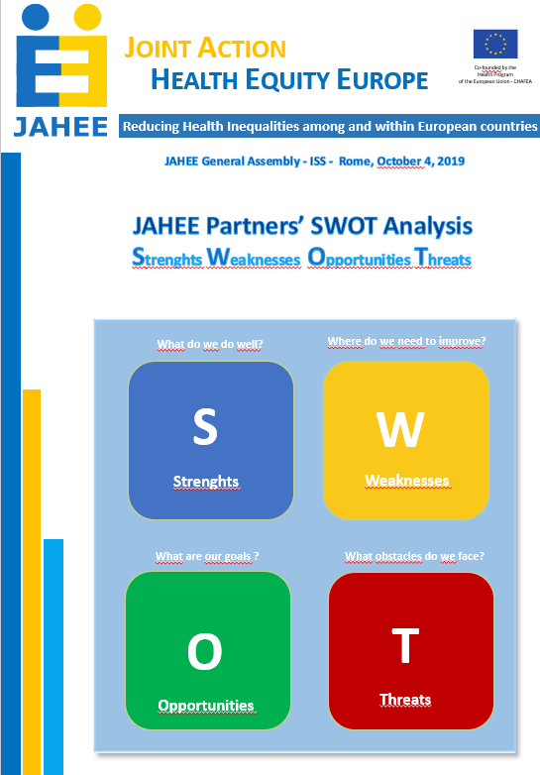
Engaging participants at the General Assembly through JAHEE SWOT ANALYSIS
Get the feelings
of JAHEE participants
at the General Assembly
Results show that…
1
2
3
4

Slide 26

ENGAGING Students and lay people
After the success of the Europena Researchers night at ISS
15 interviews
Show the feelings and perceptio on
Health inequalities
No awareness,
no understanding
A LOT TO WORK
Plan to engage schools
Questions asked
Did you ever think of HI?
Is this a problem close to you?
Do you think you can contributo to contrast HI?
Do you have suggestions?
E TU, COSA FAI?
E TU, COSA FAI?

Slide 27
To sum up: What is expected from you
to contribute to the most effective communication and dissemination
Contribute to the stakeholder survey
Inform us about all relevant activity, progress, actions, meetings, recommendations that need to be communicated and disseminated
(not only deliverables, milestones)
Contribute to JAHEE social communication (Twitter)
Contribute to the JAHEE website by providing all relevant information
Mention JAHEE whenever appropriate in all relevant activities you carry on, also outside the JA («non converted» contacts, networks, articles, editorials, meetings, websites, blogs, etc.)
Provide feedback
on the suggested communication and dissemination plan and tools

Slide 28
To sum up: What is expected from WP2
to contribute to the most effective communication and dissemination
Participants will benefit from:
Communication and dissemination tools logo, templates for reports, power point presentations,
leaflet, videos, poster, standard terminology
all in WRIKE platform
Results of Stakeholder analysis
Website
Editorial support on final JAHEE final drafts

Slide 29
THANK YOU
paola.decastro@iss.it
WP2 - Dissemination

