Slide 1

EU institutional change: state of play and opportunity for engagement
Caroline Costongs
Director of EuroHealthNet
JAHEE plenary, 4th of October 2019

Slide 2
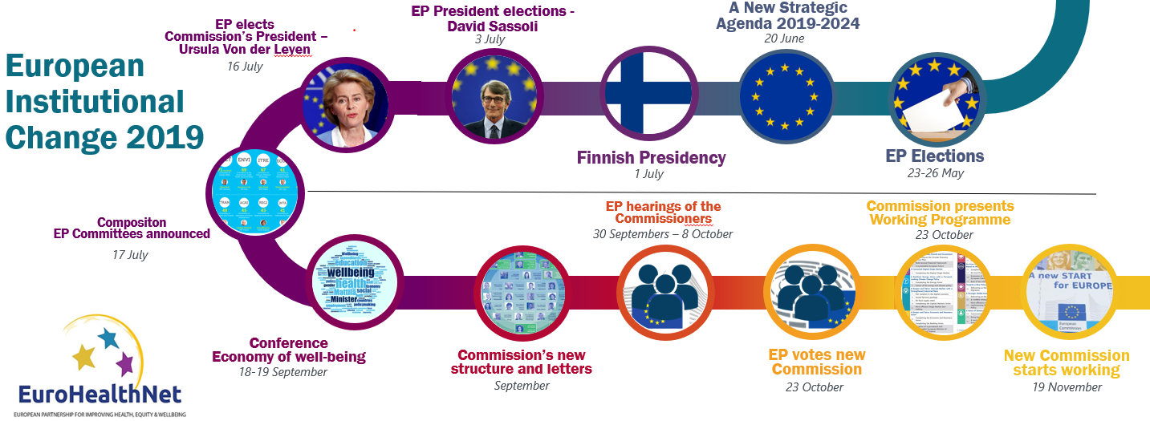
European Institutional change: state of play

Slide 3

Finland's presidency 2nd half 2019
Economy of wellbeing as an umbrella theme
Wellbeing policies and economic policies – 2 sides of the same coin
Assessment of the social, health and employment impacts of different policy measures (HEIA)
and how investing in social and health contribute to economic growth (AN INVESTMENT, NOT A COST)
Strong link with SDGs and the implementation of the Agenda2030
Council Conclusions – input on health equity
“Europe needs ‘a paradigm shift’ towards the economy of well-being”
Aino-Kaisa Pekonen, Minister for Social Affairs and Health in Finland

Slide 4
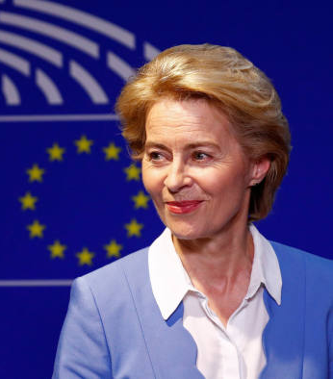
New President of the Commission
URSULA VON DER LEYEN (DE)
“We need a Child Guarantee to help ensure that every child in Europe at risk of poverty and social exclusion has access to the most basic of rights like healthcare and education. It will empower them and it pays tremendously if we back them when they are young. This is part of my Action Plan to bring our Pillar of Social Rights to life.”
“...there is also a clear and simple logic. It's not people that serve the economy. It's the economy that serves our people. In our Social Market Economy we must reconcile the market with the social. Therefore I will refocus our European Semester to make sure we stay on track with our Sustainable Development Goals.”

Slide 5
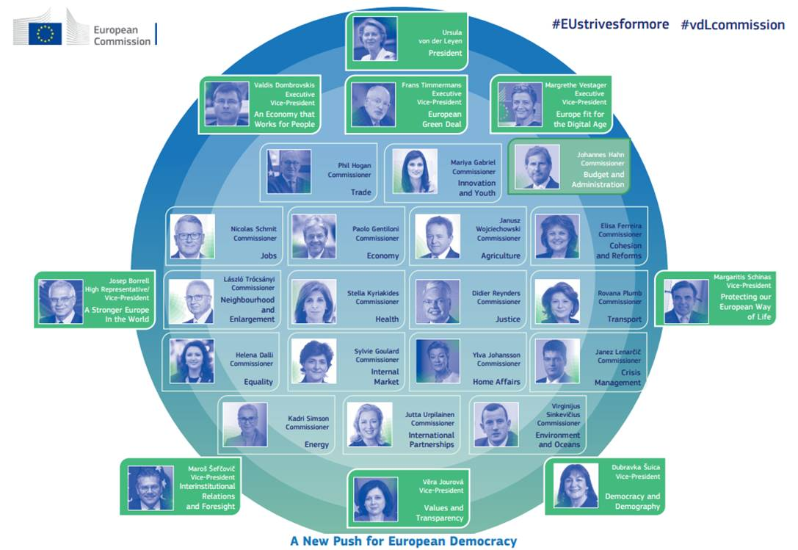
New European Commission
Three Executive Vice-Presidents political oversight with rights to input in designated areas. Work alongside VDL.
Five further Vice-Presidents They will coordinate groups of remaining 18 commissioners and work on the most important overarching issues
The Commissioners are at the centre of the structure of the new College. They will manage the expertise provided by the Directorates-General

Slide 6
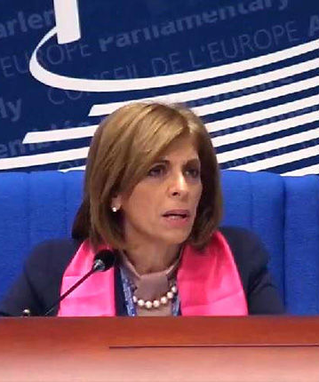
New DG Health (and Food Safety)
STELLA KYRIAKIDES (CY)
DG SANTE (stronger but more medicalised).
Pharmaceuticals & medical devices units moved (back) to DG SANTE from DG GROWTH
Main areas of focus:
European Cancer Plan
Better access to medicines
E-health for high-quality healthcare and reduce inequalities. European Health Data Space
AMR and vaccination
EC HiAP: health hardly mentioned in any of the other mission letters

Slide 7
Multiannual Financial Framework 2021-2027
Regional Development and Cohesion Policy
Policy Objective 4: A More Social Europe delivering on the European Pillar of Social Rights
European Social Fund Plus (101.2 billion)
ESF +, including EU Health Programme and at least 25% will be allocated to fostering social inclusion
InvestEU – 4th policy window on social measures and inequality
HorizonEurope – taking forward SDGs and 5 mission areas (cancer, food, oceans, climate change, climate neutral cities)
Negotiations - still ongoing, delays due to Brexit and MS differences

Slide 8
Next Steps
EU institutional change:
08/10: End of the parliamentary hearings
23/10: Election of the new college and presentation new working programme
19/11: New Commission start working
Each Commissioner to visit every MS by 2022
MFF:
Negotiation outcomes are expected at the beginning of 2020
Additional dates:
Council Conclusions on the Economy of Wellbeing at the end of October
European Semester 2020 cycle to start in the end of November
State of Health in the EU 2nd cycle to be launched at the beginning of December

Slide 9

Opportunities for JAHEE engagement – informal Policy Dialogue
Reflecting on 10 yrs of Solidarity in Health EC Communication - 2009
Representatives of Ministries of Health of the forthcoming EU presidencies – Finland, Croatia, Germany, Slovenia (and Portugal)
WHO Conference Health Equity, 11-13 June 2019, Ljubljana
Acting Director of WHO Europe and delegation on health equity
WP 4 and EuroHealthNet
=> Towards health equity in upcoming council Presidencies
9

Slide 10
Conclusions
– informal Policy Dialogue
Conclusions
The problem of persisting health inequalities has been largely explored over the past decade
Many political frameworks have been developed but implementation lags behind
Policymakers should step up concrete actions in order to achieve tangible results closer to citizens
Need to bridge supranational level initiatives with local realities

Slide 11
Opportunities for JAHEE engagement
AIM: to maintain health equity high on EU & MS political agenda’s and continue cooperation
Working towards Council conclusions including health equity - Taking forward support to Presidencies
2nd Policy dialogue linked to senior level working party and/or with health attache’s – testing our messages
Meeting new Commissioners (Kyriakides, Gentiloni on Semester-SDGs, Suica on demographic change, Schmit on EPSR etc) – welcome letters
Providing input to European Semester cycle in 2020, - based on JAHEE country assessments
Input to Action Plan on European Pillar Social Rights

Slide 12
Opportunities for JAHEE engagement
AIM: to maintain health equity high on EU & MS political agenda’s and continue cooperation
Presenting JAHEE outputs at Social Protection Committee – liaison with indicators sub-committee
Steering Group on Promotion and Prevention – continued funding for JAHEE best actions
Provide recommendations to ESF+ programme committee and health working group
Make use of European Structural Support Services (25 billion) – MS applications every October
Respond to Policy Consultations with JAHEE outcomes and deliverables (for example on migration)

Slide 13
Caroline Costongs, Director, c.costongs@eurohealthnet.eu
Vania Putatti, Policy Officer, v.putatti@eurohealthnet.eu
Alexandra Latham, Comms Coordinator, a.latham@eurohealthnet.eu

