Slide 1
JOINT ACTION
HEALTH EQUITY EUROPE
Joint Action Management Plan
Work Package N 1 – Management of Action
Istituto Superiore di Sanità, Italy
Raffaella Bucciardini
JAHEE General Assembly
Rome, 04 October 2019

Slide 2
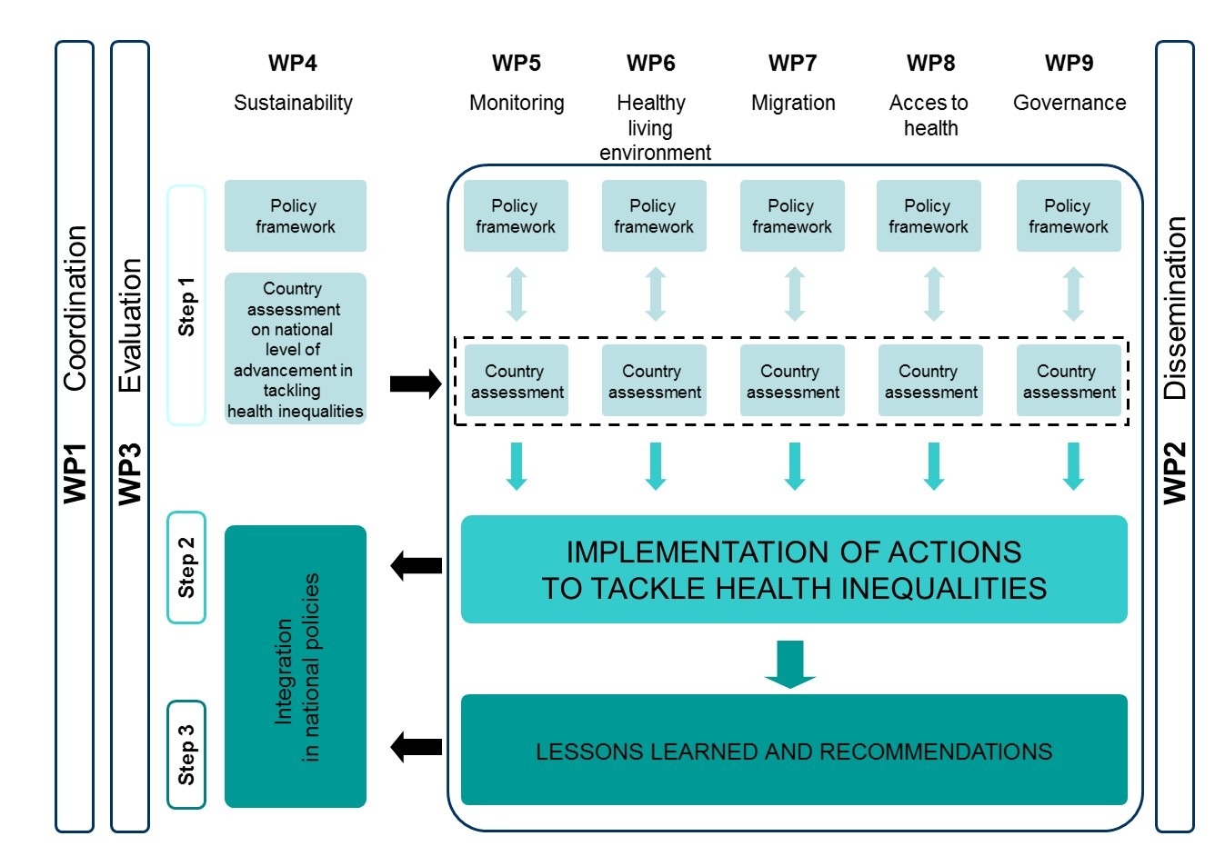
Scheme of the jahee structure

Slide 3
What Has ChaNged?
A first amendment is going to be submitted.

Slide 4
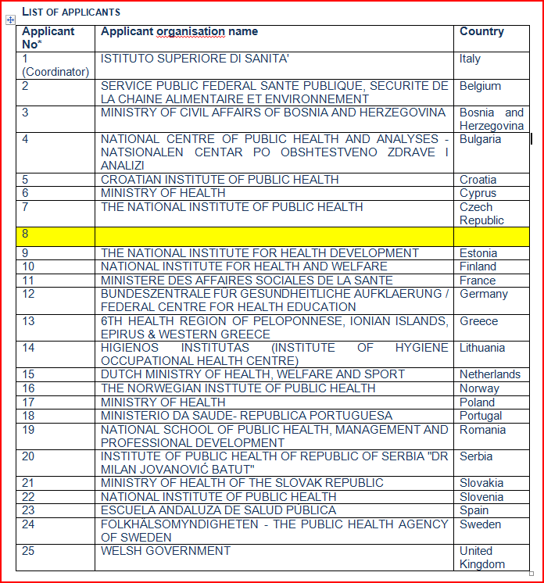
Participating CountrIEs

Slide 5
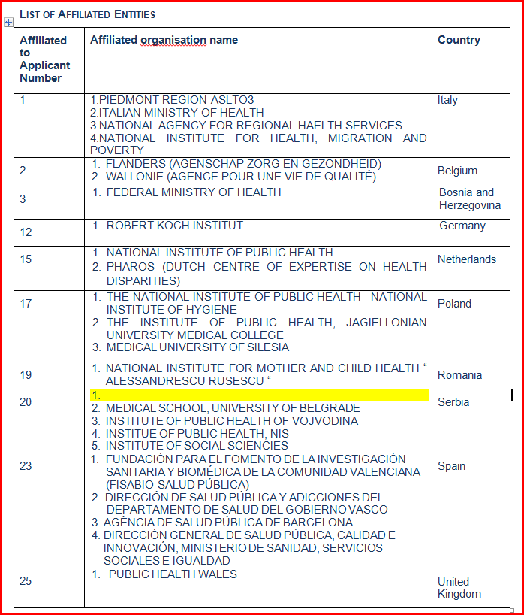
Participating CountrIEs

Slide 6
DELIVERABLEs AND MILESTONES
In total:
27 Deliverables
45 Milestones
Some changes were made with respect to deliverables and milestones delivery dates.

Slide 7
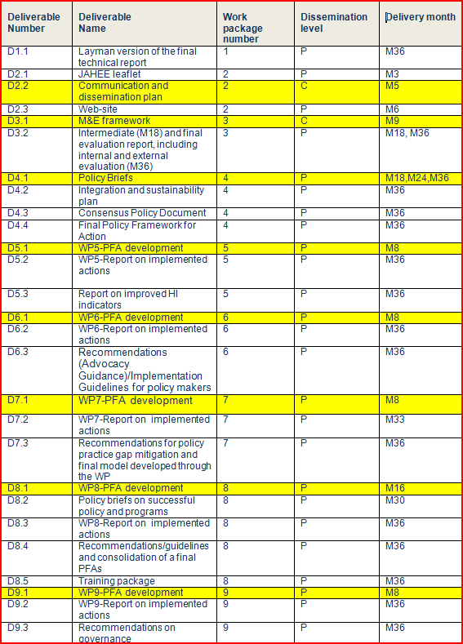
delivErables

Slide 8
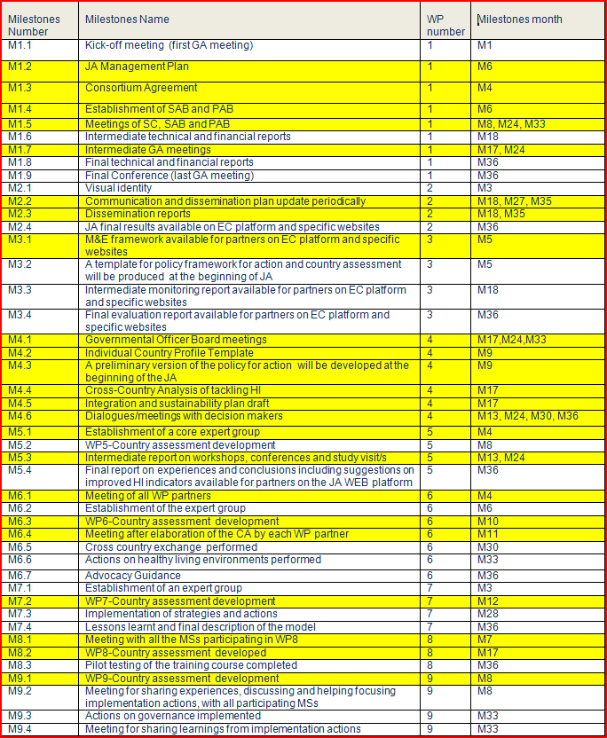
milestones

Slide 9
WP1-milestones

Slide 10


Slide 11


Slide 12


Slide 13

Milestone 1.5:
A first meeting between Steering Committee and the PAB/SAB
was held on January 2019

Slide 14
M1.6 Intermediate technical and financial report
The NEXT milestone is planned by the end of this year!!

Slide 15
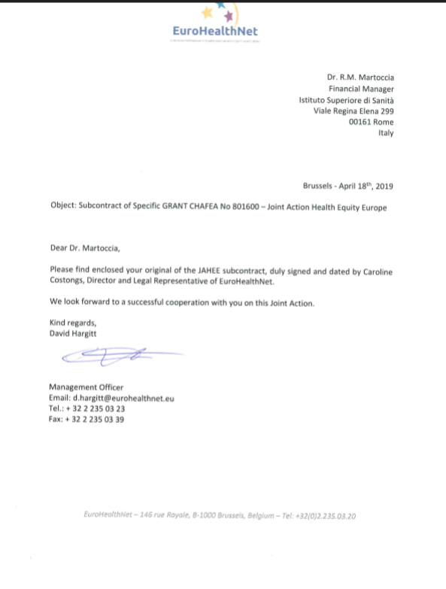

Slide 16

WHAt can we improve ?

Slide 17
BUDGET FREQUENT QUESTIONS
Thank you…..

