Slide 1



Center for Global Health Inequality Research
Prof. Terje A. Eikemo
Dr. Mirza Balaj
@CHAIN_NTNU
https://www.ntnu.edu/chain#/view/about
CHAINNTNU

Slide 2
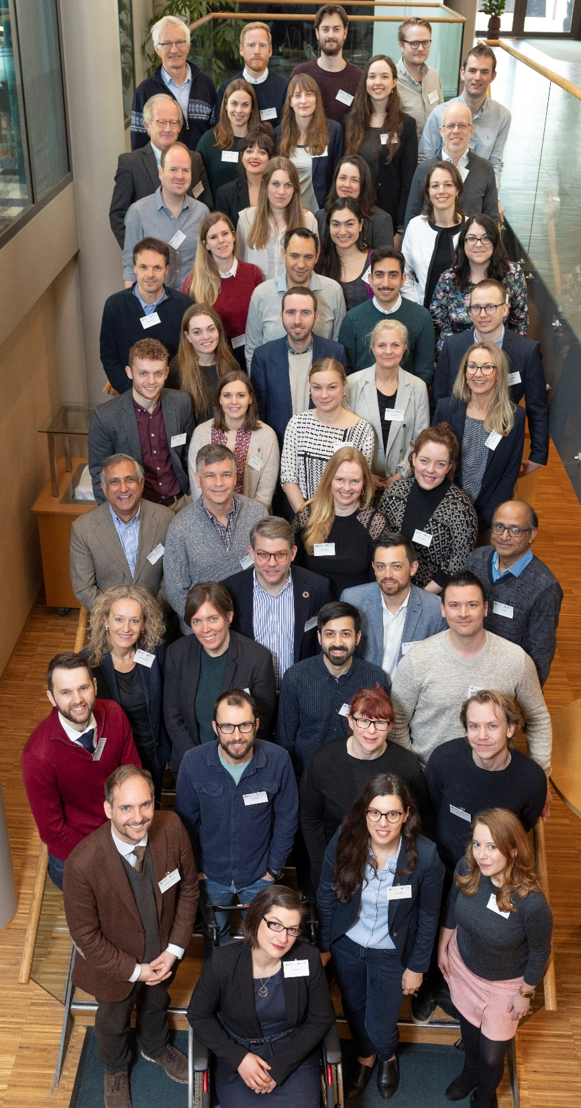

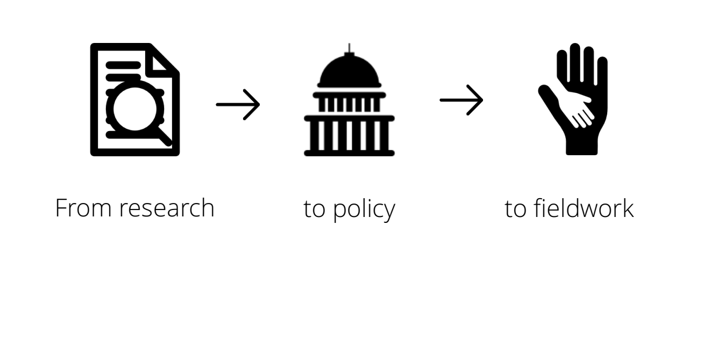
Notes:
Today, CHAIN is the first and only centre of its kind in the world. It is unique because it brings universities, politicians, practitioners, international organisations, think-thanks, the civil sector and the UN-system together in the same organizational body with a common mission: to reduce the global health through the CHAIN approach.
The CHAIN approach consists of 3 main steps. Research, policy, and practice.
In terms of research, CHAIN is measuring and explaining the problem of inequality in the world, to an extend that has not been done before. But it is not enough.
We also need to change policies that can reduce inequalities. This is why we are constantly reaching out to policy makers, the European Commission and international governments. This is why organizations such as EuroHealthNet based in Brussels and UNICEF Norway are key partners of CHAIN. UNICEF has offices all over the world, which gives us global reach.
Still, changing policies is also not enough. There are millions of people who are suffering every day, and they do not have time to wait for changed policies. They need to help now, where they are.
This is why we are working with organisations, such as UNICEF, who are helping people on the ground at all times. This means that we do not have to design our own interventions, which is expensive, time-consuming and ineffective. Instead, we can evaluate ongoing interventions of our partners and provide immediate input, which can improve people`s conditions long before new policies can.
I will now provide you a few examples of the CHAIN approach, related to each of these steps.

Slide 3
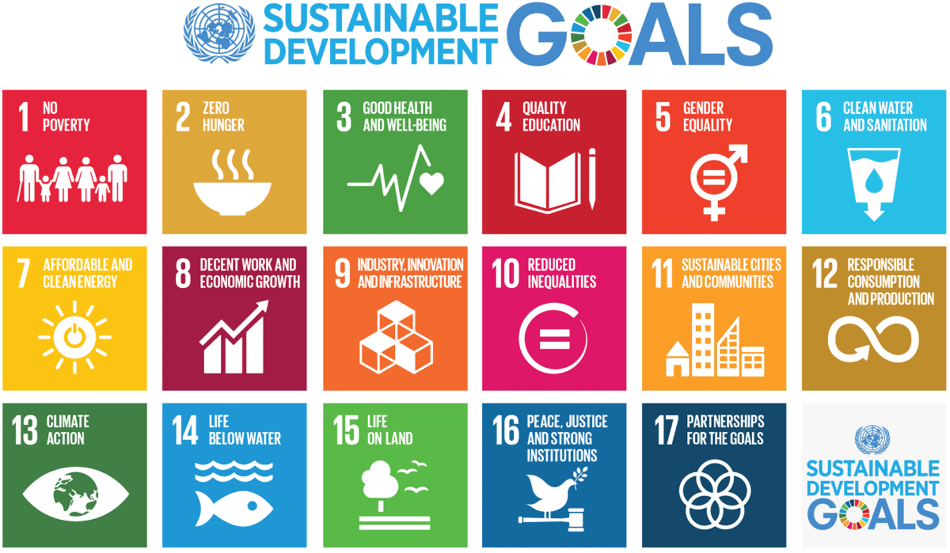
Notes:
This aligns with the 10th sustainable development goal. And this is also the mission of CHAIN.

Slide 4
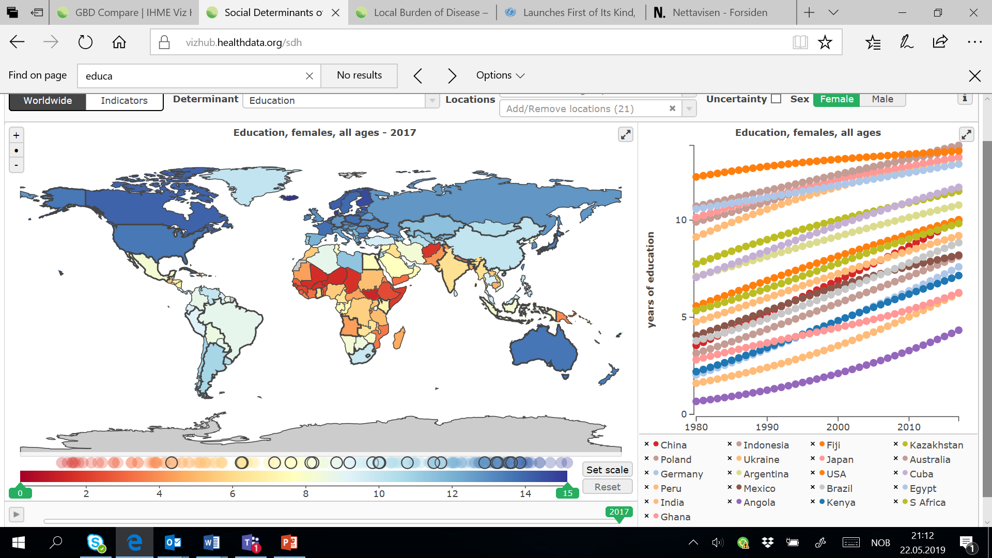
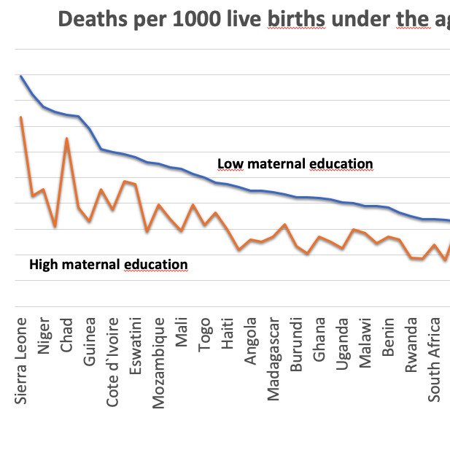
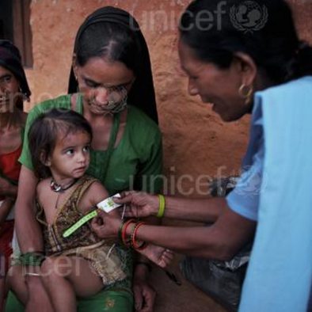
MONITORING
EXPLAINING
REDUCING
Notes:
The fact that inequality kills at such a large scale made us take a global responsibility to monitor the extent of health inequalities in the world, to explain their causes, and to identify policies, institutional conditions and interventions that can reduce them.
Monitoring, explaining and reducing health inequalities in the world are therefore three main research objectives. We will cover all world regions. We will focus on all age groups, but particularly children because we know that inequalities start to emerge early in life, and we will focus on all dimensions of inequality, such as education, income, gender, and ethnicity.

Slide 5
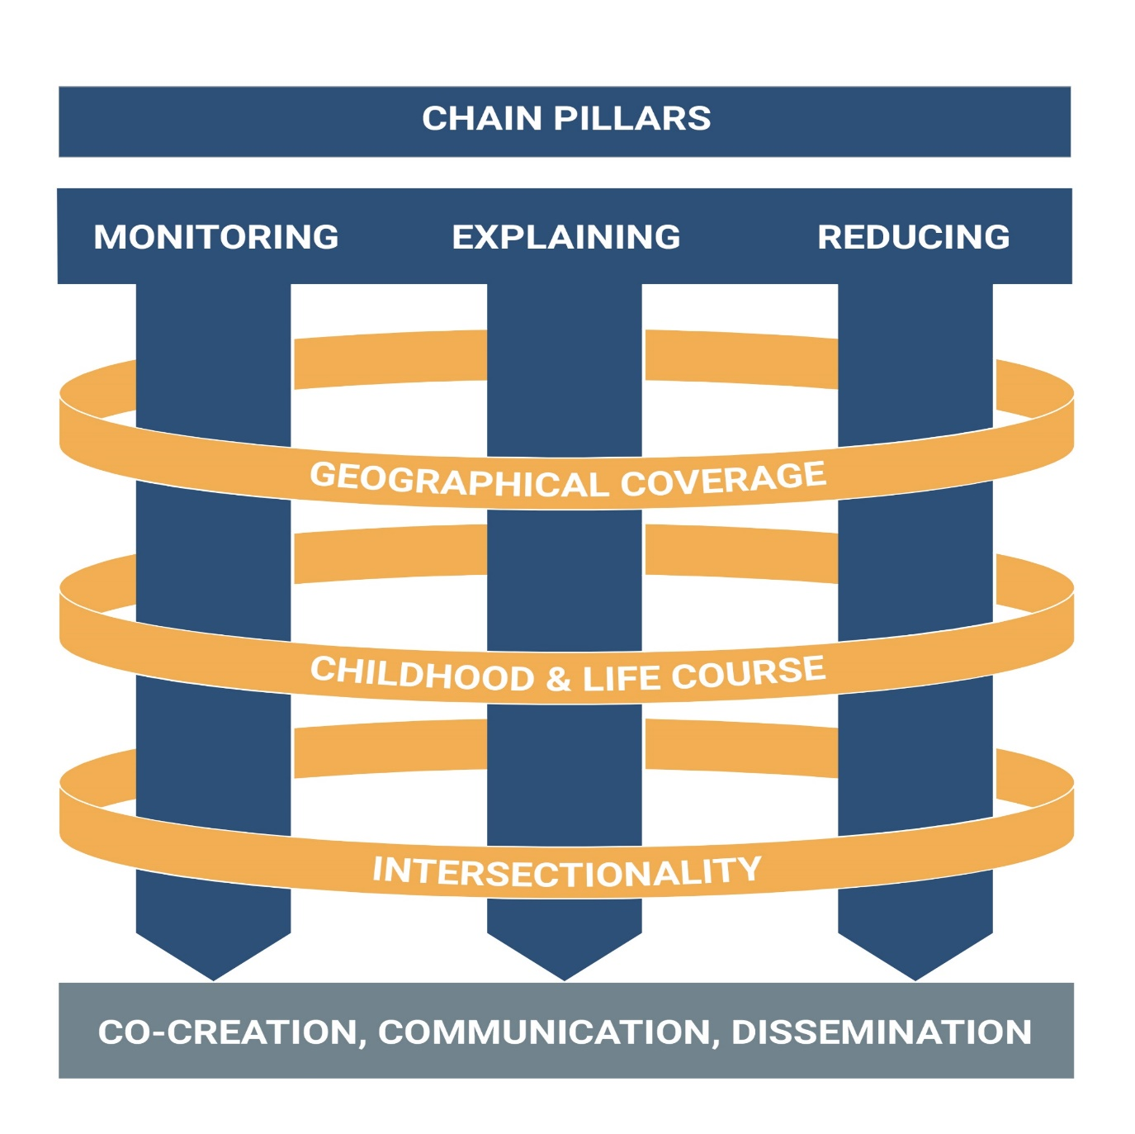
Notes:
The fact that inequality kills at such a large scale made us take a global responsibility to monitor the extent of health inequalities in the world, to explain their causes, and to identify policies, institutional conditions and interventions that can reduce them.
Monitoring, explaining and reducing health inequalities in the world are therefore three main research objectives. We will cover all world regions. We will focus on all age groups, but particularly children because we know that inequalities start to emerge early in life, and we will focus on all dimensions of inequality, such as education, income, gender, and ethnicity.

Slide 6
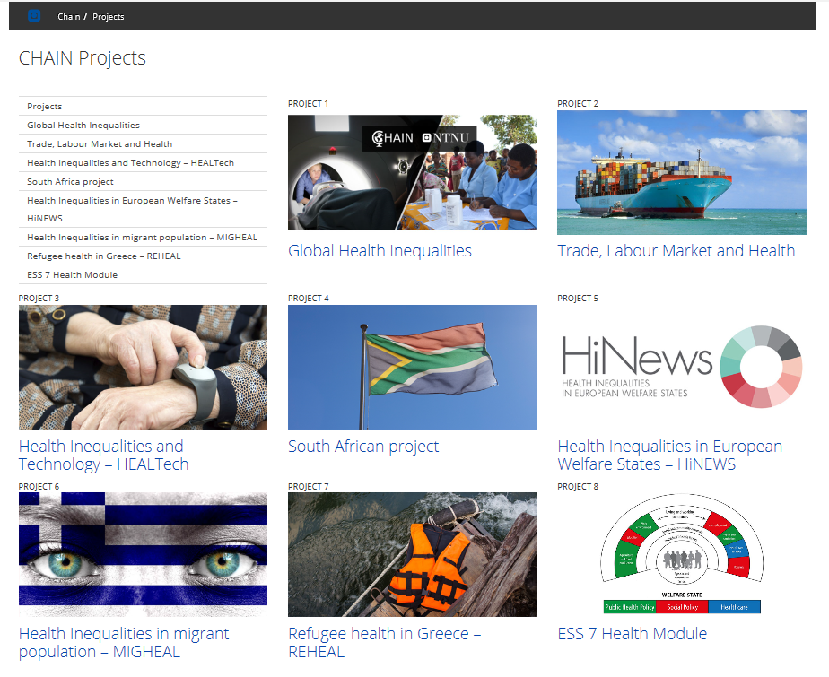

Slide 7
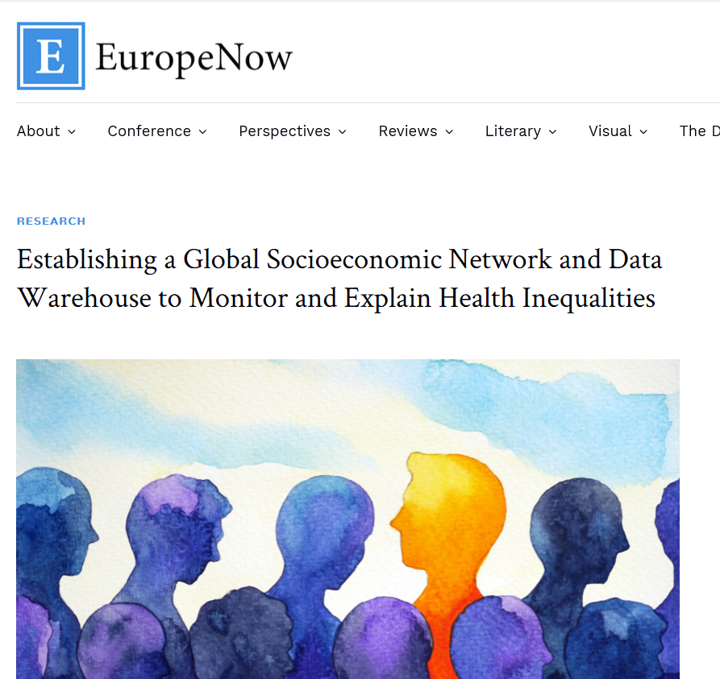
“The GBHI data warehouse will compile and provide access to individual-level data on inequalities in health (mortality and morbidity), by socioeconomic position and (where available) by their determinants (material living conditions, behavioural risk factors, and access to healthcare) in as many countries as possible, covering all world regions”.
https://www.europenowjournal.org/2019/06/10/

Slide 8
Socioeconomic positions as a risk factor in the GBD
Education
Parental education as a risk factor for all-cause child mortality
Own education as a risk factor for (own) all-cause mortality
How:
Literature reviews (5000 articles identified for child mortality, 30 000 for adult mortality)
Establishment of a global socioeconomic network

Slide 9
Parental education and child mortality review
Why a review
Monitoring, explaining and reducing inequalities
→ estimating the protective effects of parent’s education on child mortality
The process
7 databases searched
→ 4,558 abstracts screened
→ 1,101 full text screened
→ Data extracted from 278 articles
→ A meta-analysis and a systematic review of findings
@CHAIN_NTNU
https://www.ntnu.edu/chain#/view/about
CHAINNTNU
Notes:
Child mortality review
It is known that there is a large gap in life expectancy between people of high and low education, however, the exact extent of this phenomenon on a world-basis is not yet known. Moreover, the collection and harmonization of such data is essential to monitor, explain and reduce inequalities within health, which make up the research objectives of CHAIN.
Since January, seven people including myself have been working on the part of the project which explores the link between parents’ education and child mortality.
Process: The first phase of the study consisted of searching 7 databases, gathering 4,558 articles which would then go through a manual title/abstract screening to identify which articles contained information about both child mortality and parental education. Then, a total of 1,101 articles that contained data on these two factors would be part of a full text screening, where the articles were included or excluded based on phenomenon of interest (child mortality according to parental education), study design and evaluation (the article had to include an individual level measure and have the correct effect size measure). Sample characteristics (for example, if the population was representative or not) was later reported in the extraction. After this process, 278 [+/- 2 foreign languages ones] articles were left for extraction of data, using IHME’s template for calcultaing the health effects of individual risk factors.
The team is currently finalizing the extraction phase, in which the actual data on child mortality and parental education was obtained. Here we would also note down if the results were adjusted for other factors such as for example age, income or migration status as well as a lot of other factors, characteristics of the study population, how, when and where the data was obtained, and the specifics of how mortality and education were defined.
The next step includes a meta-analysis in collaboration with our IHME colleagues and a narrative synthesis of the results.
Ultimately, the collected data will be utilized by the Global Burden of Disease Study to estimate the protective effects of education on child mortality.

Slide 10










@CHAIN_NTNU
www.ntnu.edu/chain
CHAINNTNU

