Slide 1
Technical and Financial Periodic Reporting
Paola D’Acapito
Scientific Project officer, Health and Food Safety Unit
European Commission
Consumers, Health, Agricuture and Food Executive Agency (Chafea)

Slide 2
OUTLINE
REPORTING IN PRACTICE - Elaboration of the requested documentation
ROLES AND RESPONSABILITIES
CHAFEA ASSESSMENT

Slide 3
REPORTING IN PRACTICE –
Elaboration of the requested documentation

Slide 4
Where?
EC Funding and Tenders Portal:
https://ec.europa.eu/info/funding-tenders/opportunities/portal/screen/home

Slide 5
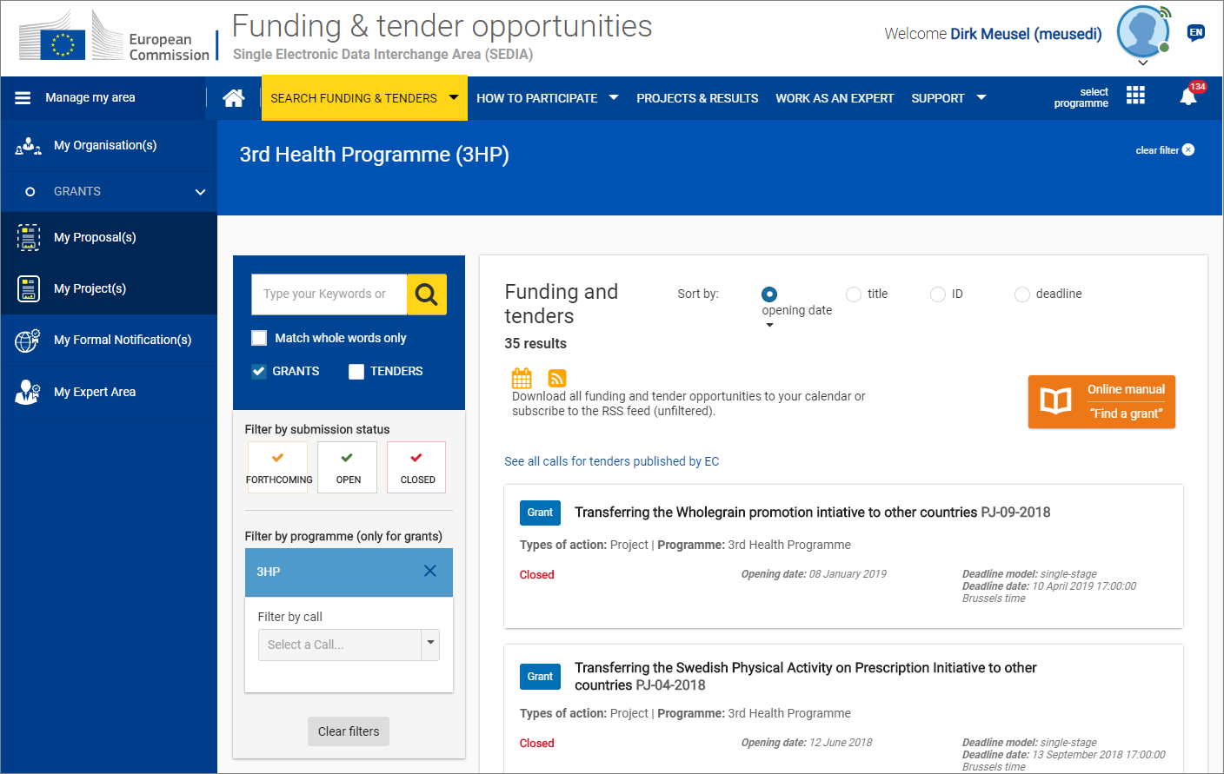

Slide 6


  TECHNICAL REPORTING –
  monitoring, update and fulfillment/elaboration of specific components
Project Continuous Report
Project Periodic Report

Slide 7


Summary for publication
It is a narrative stand-alone text - used both internally (Commission Services) and externally (Health Programme Database) - which introduces the project by addressing the following points:
  Summary of context, overall objectives, strategic relevance and contribution of the action to the EU Health Programme
  Methods and means
  Work performed during the reporting period
  The main outputs achieved so far and their potential impact and use by the target group (including benefits)
  Achieved outcomes compared to the expected outcomes
  Dissemination and evaluation activities carried out so far and their major results (focus on tangible and measured results)
  Conclusions and options for future use (make them specific)
  Open Keywords (for our research tool on the database
  The address (URL) of the action's public website (main dissemination tool)
  Images attached to the Summary for publication (logo, picture, graph that we will use as illustration in our publications)

Slide 8

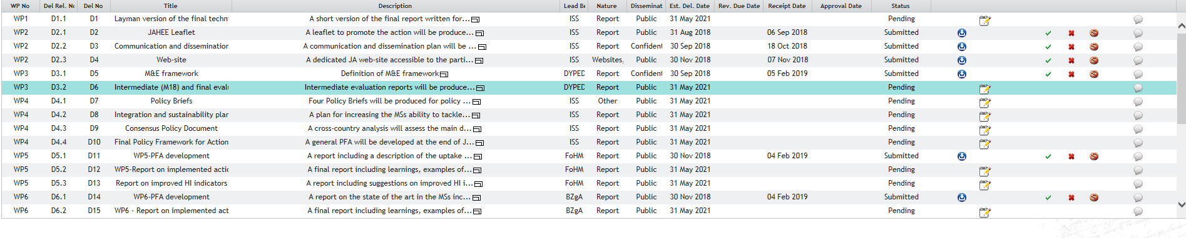
Deliverables

Slide 9


3. Critical Risks
The content is extrapolated from Annex 1 of the GA but it can and it should be updated throughut the project lifetime to monitor the risks and to record unforerseen risky events and the identified mitigation plans/actions
4. Milestones
The content is mirroring what enclosed in Annex 1 Part A of the GA and their quite relevant as a monitoring tool of the grant implementation

Slide 10

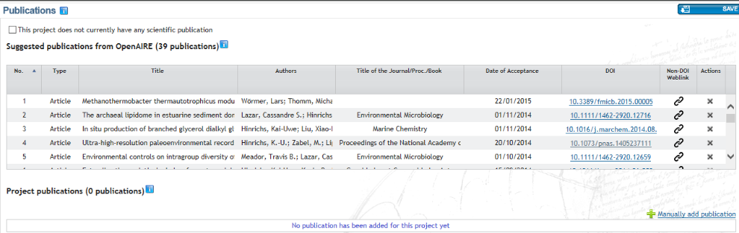
Publications
Note:
Suggested publications: a list of publications that could be linked to the project and available in Open Access repositories
Project publications: shows the publications which the Consortium has confirmed as linked to the project (by clicking on a suggested publication and clicking on Import Publication)

Slide 11
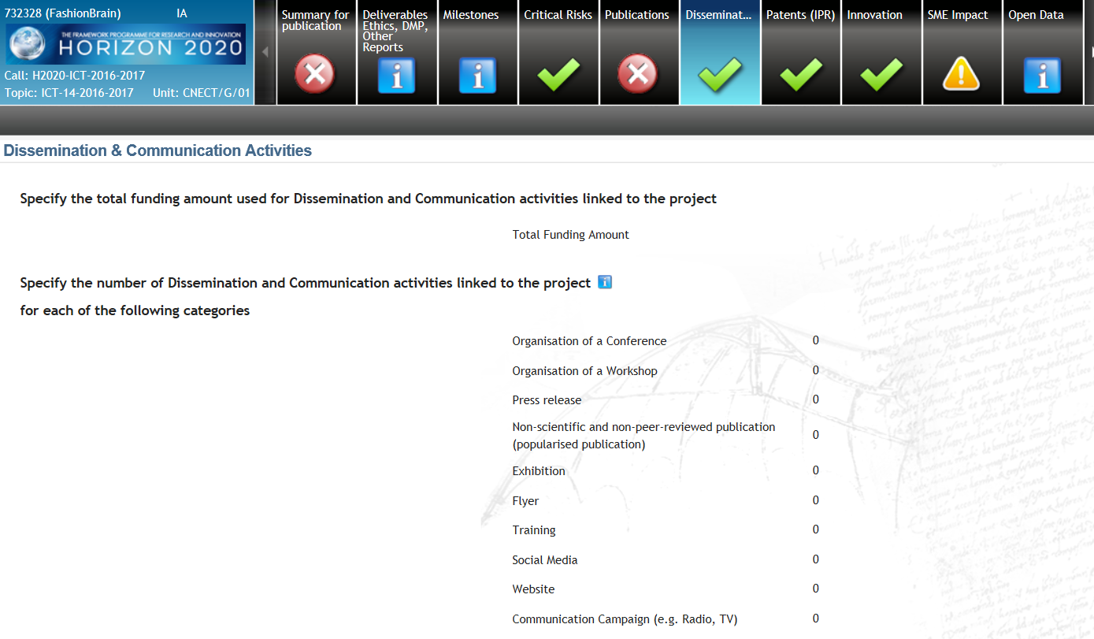
Dissemination

Slide 12

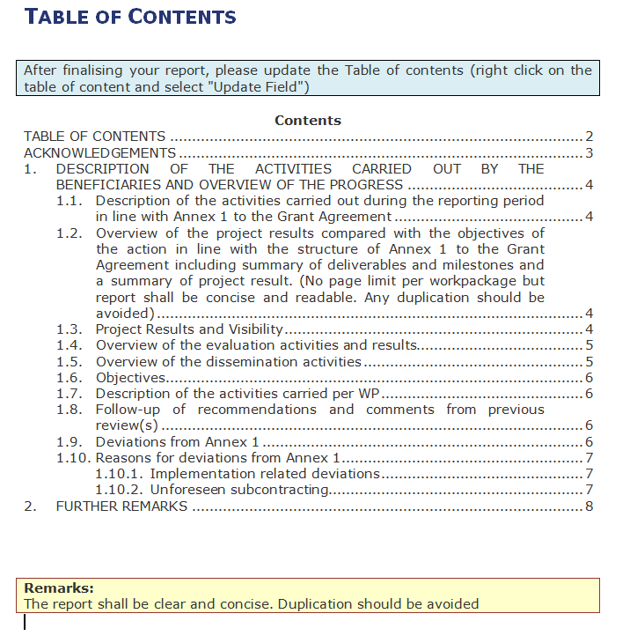
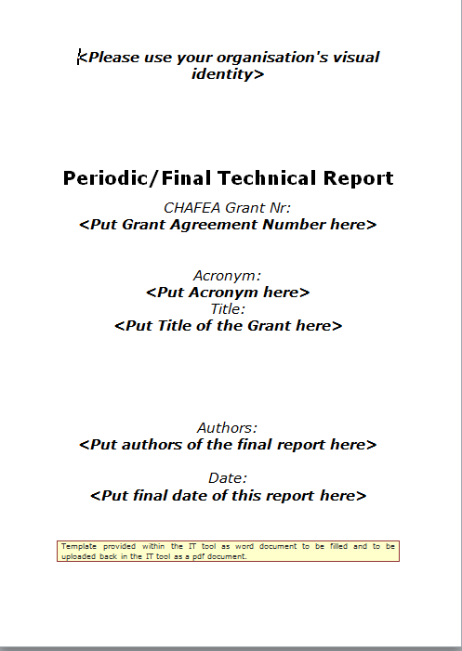

Slide 13
Grant agreement provisions –
Periodic/Final Reports
ARTICLE 15 — REPORTING — PAYMENT REQUESTS
15.1 Obligation to submit reports,
The coordinator must submit to the Agency the technical and financial reports set out in this Article. These reports include the requests for payment and must be drawn up using the forms and templates provided in the electronic exchange system.
15.2 Reporting periods, the action is divided into the following ‘reporting periods’:
- RP1: from month 1 to month 12 (or 18)
- RP2: from month 13 to month 24 (or 36)
Notes:
WARNING!!!!!
The numbering of the MGA you signed are not necessarily the same that you can find on the H2020 on-line Guide

Slide 14
15.3 Periodic reports — Requests for interim payments
The coordinator must submit a periodic report within 60 days following the end of each reporting period.
The periodic report must include the following:
(a) a ‘periodic technical report’ containing:
  (i) an explanation of the work carried out by the beneficiaries;
  (ii) an overview of the progress towards the objectives of the action, including milestones and deliverables identified in Annex 1.
  This report must include explanations justifying the differences between work expected to be carried out in accordance with Annex 1 and that actually carried out;
  (iii) a summary for publication by the Agency;
  (iv) the answers to the ‘questionnaire’, covering issues related to the action implementation and its impact, if required in Annex 1;

Slide 15
15.3 Periodic reports — Requests for interim payments
(b) a ‘periodic financial report’ containing:
  (ii) an explanation of the use of resources and the information on subcontracting (see Article 10) from each beneficiary, for the reporting period concerned;
  (iii) not applicable;
  (iv) a ‘periodic summary financial statement’ (see Annex 4), created automatically by the electronic exchange system, consolidating the individual financial statements for the reporting period concerned and including — except for the last reporting period — the request for interim payment.

Slide 16
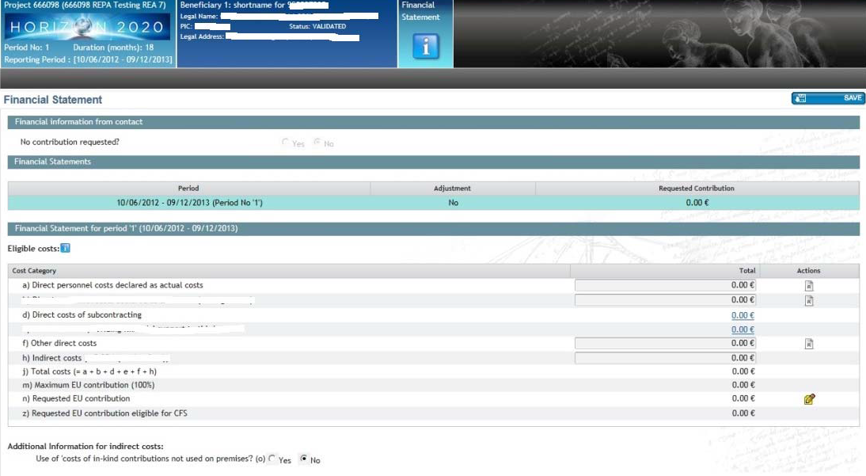
Submission of the financial report

Slide 17
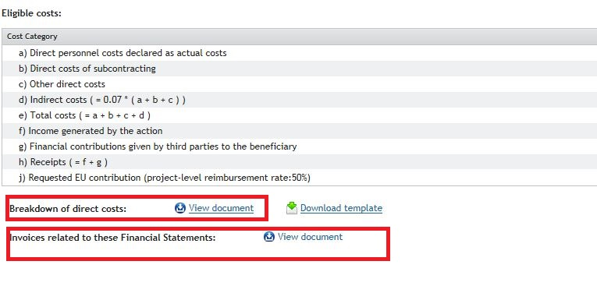
Submission of the financial report
Upload
Detailed financial statement under "breakdown of direct costs" – template can be downloaded
Upload supporting documents under "invoice related…" for equipment, subcontracting and contributions received from 3rd parties

Slide 18
ARTICLE 16 — PAYMENTS AND PAYMENT ARRANGEMENTS
16.3 Interim payments — Amount — Calculation
’……The Agency will pay to the coordinator the amount due as interim payment within 60 days from receiving the periodic report (see Article 15.3), except if Articles 31 or 32 apply.
Payment is subject to the approval of the periodic report…..’
16.4 Payment of the balance — Amount — Calculation
‘…Payment is subject to the approval of the final report…..’

Slide 19
ARTICLE 18 — EVALUATION OF THE IMPACT OF THE ACTION
18.1 Right to evaluate the impact of the action
The Agency or the Commission may carry out interim and final evaluations of the impact of the action measured against the objective of the EU programme.
Evaluations may be started during implementation of the action and up to five years after the payment of the balance. The evaluation is considered to start on the date of the formal notification to the coordinator or beneficiaries.
The Agency or the Commission may make these evaluations directly (using its own staff) or indirectly (using external bodies or persons it has authorised to do so).
The coordinator or beneficiaries must provide any information relevant to evaluate the impact of the action, including information in electronic format.
18.2 Consequences of non-compliance
If a beneficiary breaches any of its obligations under this Article, the Agency may apply the measures described in Chapter 6.
Notes:
Technical review vs financial audit

Slide 20
FSIGN, Partners, Coordinator
ROLES AND RESPONSABILITY

Slide 21
Periodic Reporting - Steps
Notification: All beneficiaries receive a notification
All Beneficiaries :
  contribute to the Technical Part of the Periodic Report
  complete their own Financial Statement
  e-sign and submit (PFSIGN) their Financial Statements to the Coordinator
The Coordinator approves & submits the elements
(Technical part and Financial Statements) of the Periodic Report
The EU Services review the submitted Periodic Report and accept or reject it
(Interim) / (Balance) Payment

Slide 22
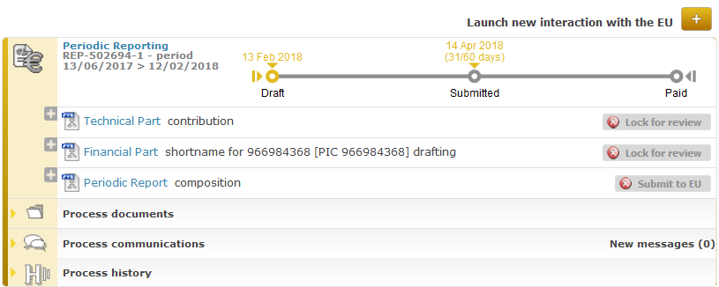

Technical Part of Periodic Reporting
Lock for review
Task to be performed by the Coordinator
Information has to be complete and up-to-date before the Technical Part of Periodic Report is 'locked for review'
Once all information for the Technical Part has been filled in, click on Lock for review
→ This action will freeze the data (prevent changes) and generate a pdf document
(the generation of the PDF might take a few minutes)

Slide 23
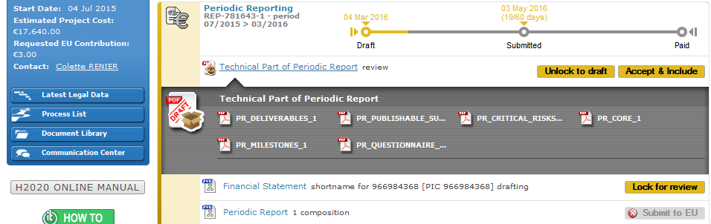

Technical Part of Periodic Reporting
→ PDF CREATED

Slide 24
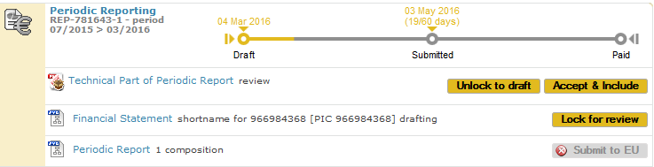
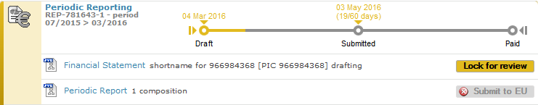

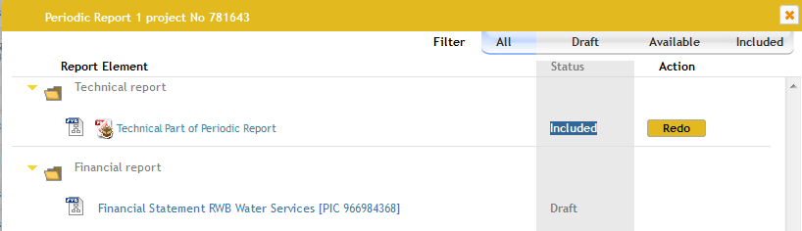
Technical Part of Periodic Reporting
ACCEPT & INCLUDE
Task to be performed by the Coordinator
→

Slide 25
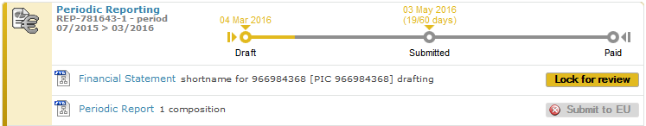

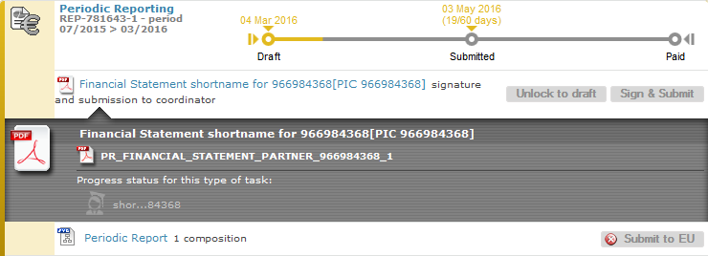
Financial Statement
Lock for review → PDF
Task to be performed by each Beneficiary
This action will freeze the data (prevent changes) and generate a PDFdocument

Slide 26
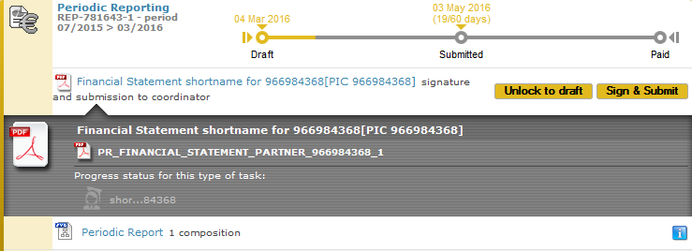
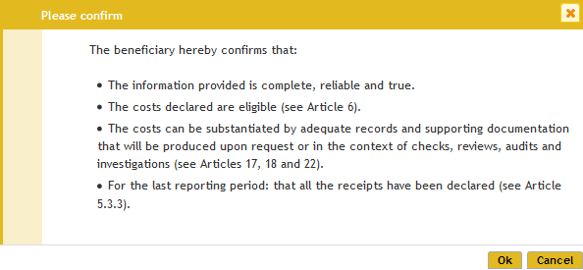
Financial Statement
SIGN & SUBMIT
Task to be performed by PFSIGN of each Beneficiary

Slide 27
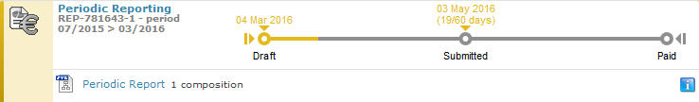
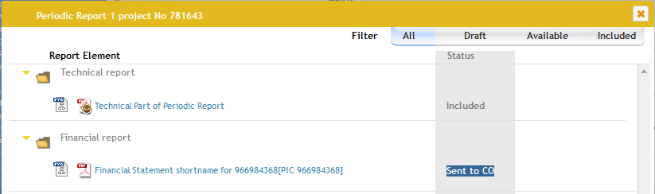
Financial Statement
"Sent to Coordinator"

Slide 28
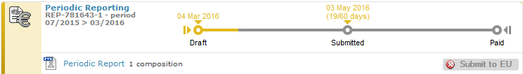
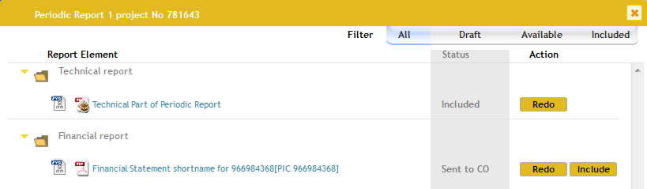
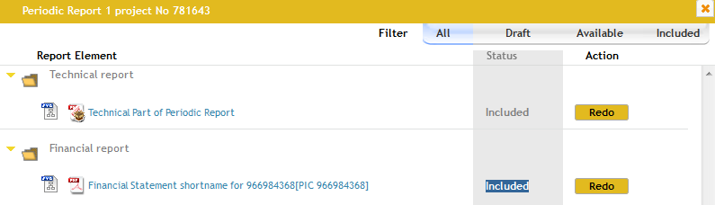
Financial Statement
to be incuded in Periodic Report
Coordinator approves by including in the Periodic Report

Slide 29
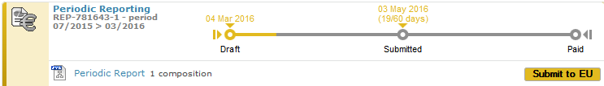
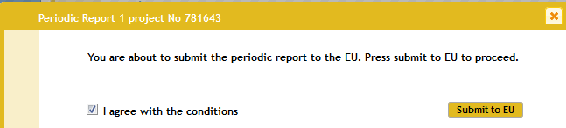
Periodic Reporting
SUBMIT TO EU
Coordinator submits to EU
Once the elements of the Periodic Report are approved, the Periodic Report can be submitted to the EU Services in one single submission
Only users with the role Primary Coordinator Contact and Coordinator Contact can perform this action

Slide 30
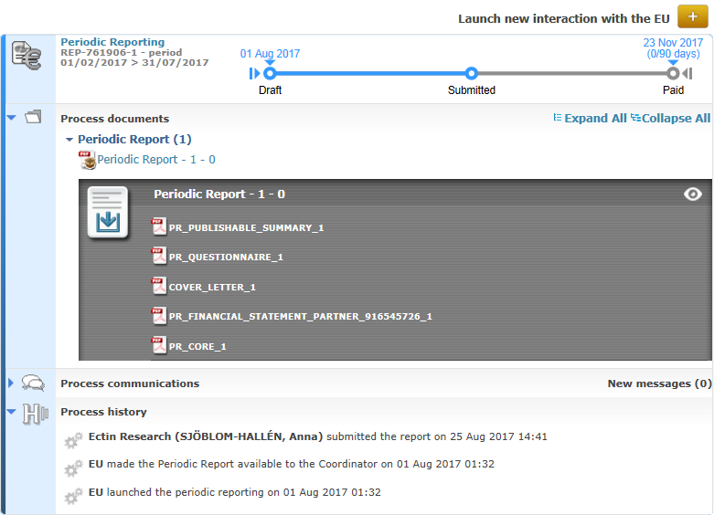
Periodic Reporting
SUBMITTED

Slide 31
  CHAFEA ASSESSMENT

Slide 32
ARTICLE 31 — SUSPENSION OF PAYMENT DEADLINE
31.1 Conditions
The Agency may — at any moment — suspend the payment deadline (see Article 16.2 to 16.4) if a request for payment (see Article 15) cannot be approved because:
  (a) it does not comply with the provisions of the Agreement (see Article 15);
  (b) the technical reports or financial reports have not been submitted or are not complete or additional information is needed, or
  (c) there is doubt about the eligibility of the costs declared in the financial statements and additional checks, reviews, audits or investigations are necessary.
31.2 Procedure
The Agency will formally notify the coordinator of the suspension and the reasons why. The suspension will take effect the day notification is sent by the Agency (see Article 36).
If the conditions for suspending the payment deadline are no longer met, the suspension will be lifted — and the remaining period will resume.
If the suspension exceeds two months, the coordinator may request the Agency if the suspension will continue.
If the payment deadline has been suspended due to the non-compliance of the technical or financial reports (see Article 15) and the revised report or statement is not submitted or was submitted but is also rejected, the Agency may also terminate the Agreement or the participation of the beneficiary (see Article 34.3.1).

Slide 33
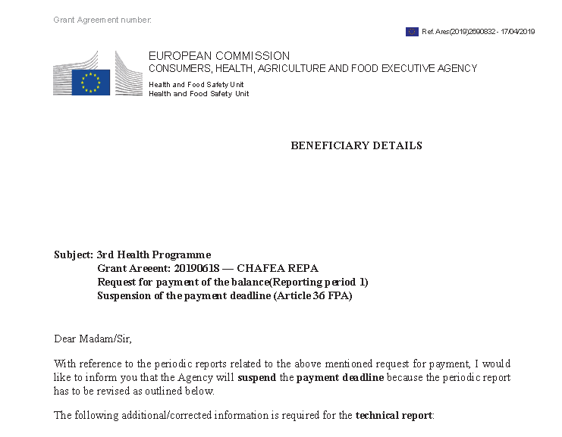
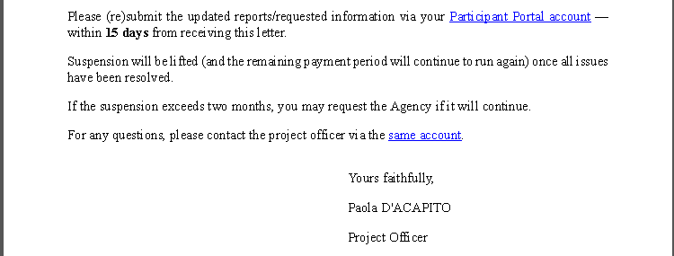
SUSPENSION PAYMENT DEADLINE LETTER
What's next?
Notes:
How to react to a suspension letter?
Read carefully the requests. If any doubt approach the PO in CHAFEA
Either provide (re-upload) the requested revised or missing documentation or
Send the requested clarifications. How? Best way is a formal notification via the system: it is transparent, immediately registered and archive in the records of the file.
The formal notification could be anticipate

Slide 34
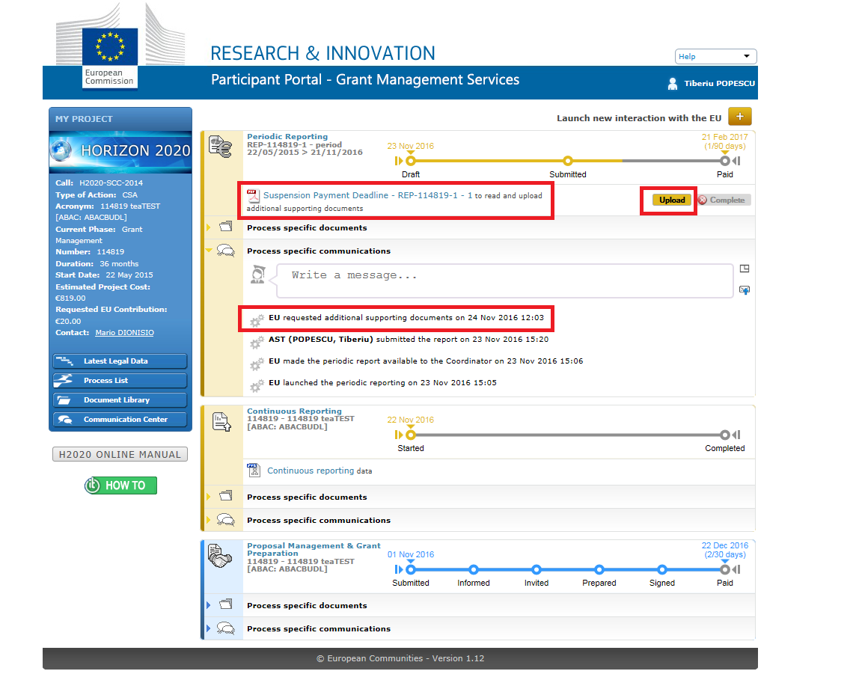
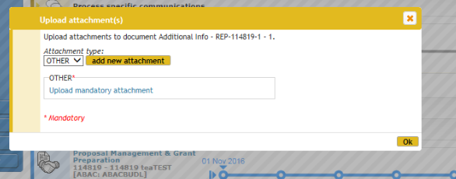

Slide 35
The floor is yours for questions
Paola D'Acapito,
PM2 cert.
European Commission
Consumers, Health, Agriculture and Food Executive Agency (Chafea)
Health and Food Safety Unit
+352 4301 34032
paola.d'acapito@ec.europa.eu
http://ec.europa.eu/chafea/

