Slide 1
JOINT ACTION
HEALTH EQUITY EUROPE
A preliminary comparative analysis of WP4 country assessments
Rome, 4 October, 2019
General Assembly
Michele Marra, ASLTO3, Piedmont Region
Angelica Valz Gris, University of Turin
WP4 Integration in national policies and sustainability
Co-founded by the Health Program
of the European Union - CHAFEA

Slide 2
WP4 - Integration and sustainability:
aims
Objective of WP4 is to understand how to raise the importance and impact of the JAHEE results, to facilitate their inclusion in the national and European political agenda and to ensure sustainability of the actions implemented during the project.
In order to do this, WP4 has started elaborating and assigned to each participating country two templates aimed at understanding how health inequalities are approached
to evaluate the level of advancement in the governance of health inequalities in different MSs
to collect the main policies implemented in each country acting on the social determinants of health
Notes:
promote that the results of the JA will find proper and adequate space and timing in the national, regional and local political agenda in MSs
raising awareness, interest and political support
supporting national plans development
presenting the results in a set of clear recommendations and policy implications
adaptable to the specific MSs needs, capacities and level of acceptance

Slide 3
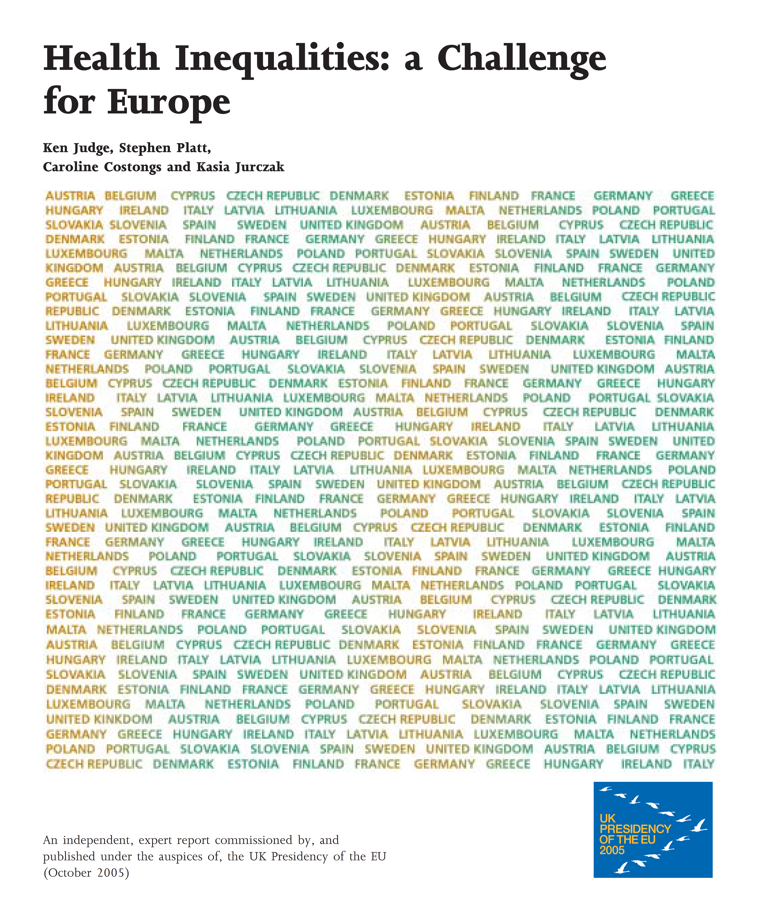
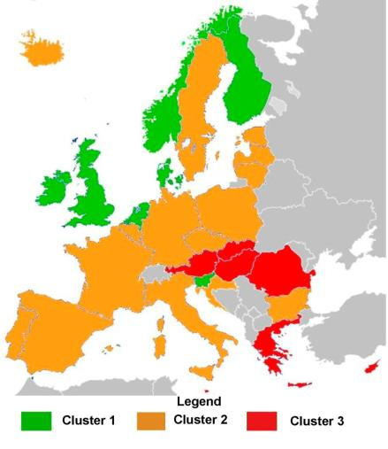
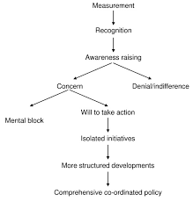
Country assessment starting points
2006
2012
Because of the changing context
New trends after EU strong commitment on HI
Because of progress on policies and need to distinguish approaches to tackle HI
previous review are quite broad and provide only few information on specific country profiles

Slide 4
Limits
20 country assessments received (still missing Cyprus, Lithuania and Slovakia) in different times and after many reminders.
Complexity of CA
Different level of validation
Different quality in filling the questionnaire
  association between quality and level of governance (level of awareness?)
  enthusiastic/catastrophic approach?
Presence of different levels of governance and implementation of actions (Belgium, Germany, Spain, Netherlands).
DYNAMIC APPROACH, NOT DEFINITIVE RESULTS!!!
Notes:
Complexity: many of you have reported difficulties in filling
Only 4 countries have performed a final validation (Italy, Norway, Netherland and Germany): only because JAHEE responsabilities?
All of them interviews with key expert working in their organization, only 10 other external health and 6 not health

Slide 5
Template A:
Governance of health inequalities in Europe
Legal framework, strategies and policies to tackle HI/SDH (approaches, vertical level, targets, on HI)
Sustained policy commitment
(agenda, mechanisms to protect commitment, funding)
Role and equity of the health system
(access, health care, prevention, skills and resources on HI, advocacy)
Accountability on HI and on the SDH
(who is responsible and how)
Active intersectoral working and health in all policies (institutions & experiences)
Monitoring of system performance and evaluation
(tools and report mechanisms on progress)
Communication, public engagement and community participation mechanisms which promote involvement of local people and stakeh.in problem definition and solution develop.
AIMS: To describe how health inequalities are approached in each country and how to group countries in clusters

Slide 6
Legal framework
A
The are specific public policies or strategies that are explicitly linked to the objective of reducing specific aspects of health inequalities
B
Health equity is explicitly considered within more general sets of public health policies
C
In these countries equity in health is implicitly or indirectly present in laws and strategic documents.
A | B |  | C
Finland | Belgium* | Portugal | Bulgaria
Italy | Estonia | Slovenia | Croatia
Norway | Germany | (France) | Romania
Spain | Netherands | (Greece)
Sweden | Poland | (Serbia)
Wales
Czech R.

Slide 7

Legal framework
Different approach to Health Equity:
Well-being of Future Generations (Wales) Act 2015: long-term strategic document which as a whole guarantees a political commitment, an inter-sectorial work and a involvement of the population on social issues that affect SDHs and His.
National Strategy on Health Equity (Spain) : document contains a proposal of 166 specific recommendations to reduce health inequalities in Spain (in short, mid and long term), drawn up by the commission on the education of Social Inequalities in Health in Spain.
Health 2020 (CZR) - National Strategy for Health Protection and Promotion and Disease Prevention, a practical policy framework focused on improving health and well-being of the population, reducing health inequalities and strengthening the role of public health.
Notes:
Different approach but in all of them Health equity is within the objetive and is considered like an intersectoral issues

Slide 8
Political commitment
A
Commitment on health inequalities is solid among decision makers and its continuity is guaranteed by a strong social interest or guarantee mechanisms.
These countries report a clear commitment and awareness among public health professionals and a rising interest among decision makers but there are not mechanisms to ensure continuity
B
C
Little interest and awareness on the subject.
A | B |  | C
Finland | Belgium | Portugal | Croatia
Norway | Bulgaria | Slovenia | Romania
Wales | Estonia | Spain | (Greece)
 | Germany | Sweden
 | Italy | (Czech R.)
 | Netherlands | (France)
 | Poland | (Serbia)
Notes:
and there is no a widespread commitment to guarantee continuous action.

Slide 9
Political commitment
Norway : example of guarantee mechanism
Norwegian Council on Social inequalities in Health provide professional high quality recommendations and help to strengthen the Directorate of Health’s effort to reduce health difference and to develop the public health strategy.
Municipalities, counties and National governments are accountable for addressing collaboration between public actors, preparedness, internal control, and supervision.
Consultation with GOs, NGOs, civil society to inform the new public health strategy
Public Health Strategy debated every 4th year in parliament

Slide 10
Equity oriented health system
A
Equity-oriented health system, with universal or almost universal access to health care and various initiatives to include equity into the spectrum of health policies.
B
Very high or universal health coverage.
Principles of equity are included in prevention programs or in other aspects of the health system but with isolated interventions.
C
In these countries there are barriers in accessing health services and equity does not seem to be taken into account very much in the creation of health policies.
A |  | B |  | C
Belgium Italy Finland Germany Netherlands | Norway Sweden Wales (France) | Croatia Poland Portugal Slovenia | Spain (Czech R.) (Serbia) | Bulgaria Estonia Romania (Greece)

Slide 11
Equity oriented health system
To notice:
16 country out of 20 report to take into account health inequalities in the prevention plan.
17 country out of 20 report that the health system promote the inclusion of health as a goal for not health care policies thanks to a role of advocacy and consulting.
Only in 7 countries the health system require healthcare providers to monitor and report on the equity of their services.
Spread and rising awareness on the impact of health inequalities, but difficulties in putting knowledge in practice.
How Doctors Can Close the GAP

Slide 12
Accountability
A
Health system is directly accountable for health inequalities at various level (national, regional, local, municipality) but in many cases responsibility is shared with other sectors and/or private actors are responsible for the health impact of their activities.
B
Accountability is attributed totally or mainly to the ministry of health, that includes it on the more general governance for health.
C
There isn’t a clear line of accountability (or it has not been declared).
A |  | B |  | C
Finland Germany Netherlands Norway Portugal | Spain Sweden Wales | Bulgaria Italy Poland Slovenia | (France) Romania | Estonia Belgium Croatia (Czech R.) (Greece) (Serbia)
Notes:
and there is no a widespread commitment to guarantee continuous action.

Slide 13
Accountability
Italy: a strong system of accountability of health services
National level has the authority in determining the core benefit package (“essential standards of care”), that must be guaranteed throughout the country (free or with cost sharing)
Regions are accountable for the delivery of essential levels of assistance under conditions of appropriateness and efficacy in the use of resources and are subject to verification. In case of fulfillment they can access to a Premium Fee of 3% of the annual Health Found.
Pilot study on the inclusion of Equity in the set of indicators of the monitoring are being made

Slide 14
Intersectoral work
A
Health inequalities are addressed mainly with a strong inter-sectoral approach
B
In these countries there are some example of intersectoral work on some project and strategies
C
In these countries, intersectoral work was not reported.
A | B |  | C
Finland Norway Wales | Germany Italy Netherlands Poland Portugal Romania Slovenia | Spain Sweden Belgium Croatia (Czech R.) (France) (Serbia) | Bulgaria Estonia (Greece)
Notes:
and there is no a widespread commitment to guarantee continuous action.

Slide 15
Intersectoral work
To notice:
17 countries out of 20 report having included the "Health in all Policy" paradigm into their agenda and the following questions show that in these country there are also various initiatives for the construction of intersectoral policies
Countries of group B have reported example of strategies that are developed with intersectoral work, for example Health 2020 of Czech Republic, Italy for Health Equity, National Health Policy of Portugal.
In group A countries the strong intersectoral component given to the topic seems to have led to the creation of more comprehensive strategies and more structured inter-sectoral work mechanisms like cross-governmental working groups.

Slide 16
Monitoring and evaluation
A
Data on HI/SDH are systematically collected and analysed, strategies are evaluated and data are used by decision makers during the creation/implementation of policies.
B
Data on HI/SDH are often available, even if information on social covariates are not systematically present in many sources. Policy makers are aware of inequalities (even if mainly within the health sector) but these data are still not so used to calibrate policies.
C
HI/SDH are purely monitored, although it is possible to obtain data on these
Only 6 countries refer to use Health Impact Assessment (HIA)
A | B |  | C
Finland Norway Wales (France) | Estonia Germany Italy* Netherlands | Portugal Slovenia Sweden* Spain* | Belgium Bulgaria Poland Romania | Croatia (Czech R.) (Greece) (Serbia)

Slide 17
Monitoring and evaluation
New developing system:
National SDH Survaillance System (Spain) provide information on SDH and health inequalities with the goal of adopting measures to protect and promote health and prevent illness as well as guiding interventions towards reducing health inequalities. Objective:
• Assessing the extent, distribution and time trends of SDH
• Monitoring and analyzing key indicators for health equity surveillance
• Promoting a comprehensive understanding of health equity departing from the data provided by all surveillance system integrated in the Network
• Actively disseminating information so that appropriate measures can be taken by concerned stakeholders, according to equity, comprehensiveness and health in all policies principles.

Slide 18
Public engagement
A
These countries have a range of mechanisms/institutions that provide opportunities for sharing and discussing policies at national level with the most important stakeholders.
Community participation in the development of actions is structured.
In these countries there are few examples of stakeholder engagement, but not structured. They count also national attempts.
B
C
In these countries, although there are some mechanisms that promote public debate or public consultation but they are very rare, limited to some specific projects and mainly at local level.
A | B |  | C
Germany Norway Spain Wales (France) Portugal | Belgium Bulgaria Finland Italy Netherlands Poland | Slovenia Slovenia Sweden (Czech R.) Romania | Croatia Estonia Poland (Greece) (Serbia)
Notes:
and there is no a widespread commitment to guarantee continuous action.

Slide 19
Public engagement
Institutional mechanism examples
The Federal Joint Committee (G-BA): decision-making body of the joint self-government of physicians, dentists, hospitals and health insurance funds in Germany. The patient involvement represents patients in the G-BA. Nationwide advocacy groups that represent patient interests or facilitate self-help for people in Germany who are chronically ill or have disabilities are entitled to take part in discussions and submit requests.
Instance de démocratie sanitarie: an association-oriented approach of all the actors of the health system in the elaboration and implementation of health policy, in a spirit of dialogue and consultation. Health democracy is exercised in France through three echelons: national (Conference National de la Santè-CNS), regional (Conference Regional de la Santè - CRS) and territorial (Conference Territorial de la Santè).

Slide 20
It consisted
Public engagement
Bottom up approach:
A large consultation to promote awareness on health inequalities and to foster the elaboration of a national strategy around the recommendations of the Review the “Italy for health equity”.
The consultation developed between 2015 and 2016 involving more than 100 interlocutors (40% of the healthcare world, 20% of the non-healthcare sector and 40% of instrumental bodies), using methods and tools that vary according to the nature and availability of the interlocutors, adapting the main messages to be communicated as much as possible to their profile.
The consultation made it possible to make these interlocutors more informed about health inequalities, to ensure that the interlocutor recognized the implications for the health equity of the actions under their own responsibility and shared their own experiences.

Slide 21
Overall assessment of governance of HI
Bulgaria
Croatia
Estonia
Grecia
Romania
Belgium
Czech Republic
France
Germany
Italy
Netherlands
Portugal
Serbia
Slovenia
Spain
Sweden
Finland
Norway
Wales
Country profile on governance of HI
Can this assessment of the governance be useful for JAHEE purpose?

Slide 22
Template on policies on the social determinants of health
To have a wider view on the governance of health inequalities,
we asked to fill a second template for policies acting on SDH
At least one policy per entry point.
SDH considered Different entry point
Year of reference From … to …
Approach to HI Direct and Explicit aim to reduce HI, HI as one of the goals, HI are one of the outcomes, SDH, HI no considered
Ministries involved Health care? All sectors?
Role of health sector Advocacy, Coordination, Planning, Implementation, E&M
Evaluation and monit Is there M&E? Which role for HI/SDH?
Target Gradient, Gap, Vulnerable groups, Society as a whole
Vulnerable groups List of vulnerable groups

Slide 23
General consideration of equity
Totally, 168 policies collected.
A clear inclusion of health and health inequalities is reported
 | N | Directly & explicitly aimed at tackling HI | HI are one of the objectives | HI are one of the outcomes | HI are considered | Indirectly on SDH | Not considered
equity from the start | 24 | 25.0% | 29.2% | 4.2% | 58.3% | 33.3% | 8.3%
foster education | 18 | 22.2% | 5.6% | 16.7% | 44.4% | 50.0% | 5.6%
fair employment | 19 | 10.5% | 21.1% | 15.8% | 47.4% | 42.1% | 10.5%
improving living conditions | 23 | 21.7% | 17.4% | 8.7% | 47.8% | 34.8% | 17.4%
social protection | 26 | 23.1% | 0.0% | 23.1% | 46.2% | 38.5% | 15.4%
community empowerment | 15 | 33.3% | 6.7% | 13.3% | 53.3% | 26.7% | 20.0%
promote gender equity | 19 | 26.3% | 0.0% | 5.3% | 31.6% | 57.9% | 10.5%
migrant | 20 | 20.0% | 10.0% | 10.0% | 40.0% | 35.0% | 25.0%
Notes:
Only 4 countries have performed a final validation (Italy, Norway, Netherland and Germany): only because JAHEE responsabilities?
All of them interviews with key expert working in their organization, only 10 other external health and 6 not health

Slide 24
Number of policies on SDH:
a run towards equity?
Country | Before 2012 | After 2012 | TOTAL
Belgium | 1 | 4 | 5
Bulgaria | 1 | 7 | 8
Croatia | 1 | 5 | 6
Czech Republic | 1 | 6 | 7
Estonia | 0 | 8 | 8
Finland | 0 | 6 | 6
France | 1 | 8 | 9
Germany | 8 | 5 | 13
Greece | 0 | 6 | 6
Italy | 4 | 7 | 11
Netherlands | 0 | 8 | 8
Norway | 5 | 2 | 7
Poland | 2 | 9 | 11
Portugal | 2 | 6 | 8
Romania | 1 | 7 | 8
Serbia | 2 | 7 | 9
Slovenia | 4 | 9 | 13
Spain | 2 | 6 | 8
Sweden | 0 | 8 | 8
Wales | 2 | 7 | 9
Total | 37 | 131 | 168

Slide 25
Main characteristics of policies on SDH
A temporal comparison is difficult but:
Cross sectoral work has increased (51,4% to 65,6%) with an increase also in the average number of ministries involved
Increase also in the variety of ministries involved (for example policies acting on the contexts as transports, urban planning and environment from 24,2% to 34%)
Dimensions of vulnerability have increased (more than 2 from 34% to 50%)
Policies not evaluated or monitored or without equity assessments have decreased (from 52,2% to 40%)
Approaches on the social gradient seem to have increased (from 27% to 37%)
The same happens for policies directly aimed at tackling health inequalities
Notes:
Only 4 countries have performed a final validation (Italy, Norway, Netherland and Germany): only because JAHEE responsabilities?
All of them interviews with key expert working in their organization, only 10 other external health and 6 not health

Slide 26
Is there a relation among governance of HI and policies on SDH? Differences still exist
It seems to be associated with the advancement of policies….
The more the governance of HI is advanced the more policies and actions acting on the SDH are equity oriented

Slide 27
The good news
Before
After
2012
Is the gap closing?
Before
After
Before
After
2012
2012
C
B
A
Much is still to be done!

Slide 28
The role of the health sector
% of policies where HI are the main
or one of the objectives of the policy
Less advanced countries should develop more capacities in putting their house in order and more attention to spread awareness of the impact of SDH on health
More advanced ok but they can still improve!
Notes:
Health sector is clearly involved in the persistence of different levels of approaches…

Slide 29
The role of the health sector
Health systems in countries more mature and more equity oriented seem more capable to influence and activate other sectors: comunication and public engagement skills needed! As well as HIA.
Cluster C countries HEA of their activities!

Slide 30
Finally:
other possible (vertical) clusterizations?
Cooperation could be promoted among countries with similarities
(as targets for example?)
81,8%
69,3%
91,8%

Slide 31
Where do we want to arrive?
Country specific profile on governance of HI and of social determinants of health
Cluster specific profile of HI and of social determinants of health
Is this enough to deal with our objectives???
Indications on how to increase equity in health
Notes:
This clusterization is a starting point. For produce this we had to produce a first profile for each country but to complete them we need:

Slide 32
Inputs for next discussion:
can template A&B help WP4 goals?
Goals of WP4
Choice of actions to be implemented in thematic WPs
Calibration of actions & their sustainiblity after the end of the project
To foster cooperation and collaboration among MSs
To facilitate the inclusion of JAHEE results in national political agendas
Goals of WP4 | Template A & B country specific | Template A & B cluster specific
Choice of actions to be implemented in thematic WPs | X?
Calibration of actions & their sustainiblity after the end of the project | X | X
To foster cooperation and collaboration among MSs |  | X
To facilitate the inclusion of JAHEE results in national political agendas | X | X
Of course template A and B can provide us useful information but if we want to give clearer recommendations we have complete our analysis with other inputs…

Slide 33
Inputs for next discussion
Goals of WP4 | Template A & B specific country | Template A & B cross country | Validation & Inputs coming from other WPs
Choice of actions to be implemented in thematic WPs | X |  | X
Calibration of actions & their sustainiblity after the end of the project | X | X | X
To foster cooperation and collaboration among MSs | X | X | X
To facilitate the inclusion of JAHEE results in national political agendas | X | X | X

Slide 34
Inputs for next discussion
Goals of WP4 | Template A & B specific country | Template A & B cross country | Validation & Inputs coming from other WPs | Information onHI trends
Choice of actions to be implemented in thematic WPs | X |  | X
Calibration of actions & their sustainiblity after the end of the project | X | X | X | X
To foster cooperation and collaboration among MSs | X | X | X | X
To facilitate the inclusion of JAHEE results in national political agendas | X | X | X | X
In order to evaluate:
priorities
To have another lens on how to give recommendations

Slide 35
Take into account the difference between level of advancement and health inequalities
Advancement in the development
of actions to reduce health inequalities
% of mortality explained by educational inequalities

Slide 36

Inputs for next discussion
Goals of WP4 | Template A & B specific country | Template A & B cross country | Validation & Inputs coming from other WPs | Information onHI and SDH trends
Choice of actions to be implemented in thematic WPs | X
Calibration of actions & their sustainiblity after the end of the project | X | X | X | X
To foster cooperation and collaboration among MSs | X | X | X | X
To facilitate the inclusion of JAHEE results in national political agendas | X | X | X | X
In order to evaluate:
priorities
consistency between policies implemented so far and needs
  And finally two question to guide your next workshop…
  How could we use this mass of information?
  Which output should we produce to better help countries?

Slide 37
Thank you!

Slide 38
Inputs for next discussion
Goals of WP4 | Template A & B specific country | Template A & B cross country | Validation & Inputs coming from other WPs | Information on SDH and on HI trends | Efficacy of policies
Choice of actions to be implemented in thematic WPs | X |  | X |  | X
To foster cooperation and collaboration among MSs | X | X | X | X | X
Calibration of actions & their sustainiblity after the end of the project | X |  | X | X | X
To facilitate the inclusion of JAHEE results in national political agendas | X | X | X | X | X
  And finally two question to guide your next workshop…
  How could we use this mass of information?
  Which output should we produce to better help countries?

Slide 39
Inputs for next discussion
Goals of WP4 | Template A & B specific country | Template A & B cross country | Validation & Inputs coming from other WPs | Information on SDH and on HI trends | Resources and efficacy of policies
Choice of actions to be implemented in thematic WPs | X |  | X
Calibration of actions & their sustainiblity after the end of the project | X | X | X | X | X
To foster cooperation and collaboration among MSs | X | X | X | X | X
To facilitate the inclusion of JAHEE results in national political agendas | X | X | X | X | X

Slide 40
How much policies impact?
Level of governance of HI/SDH is not the same of efficacy
A
B
C

Slide 41
How much policies impact?
Geographical cluster?
scand
anglo
contin
south
east
contin
south

Slide 42
Inputs for next discussion
Goals of WP4 | Template A & B specific country | Template A & B cross country | Validation & Inputs coming from other WPs | Information on SDH and on HI trends | Resources and efficacy of policies | Goegraphical inequalities?
Choice of actions to be implemented in thematic WPs | X |  | X |  | X
Calibration of actions & their sustainiblity after the end of the project | X | X | X | X | X | X
To foster cooperation and collaboration among MSs | X |  | X | X | X
To facilitate the inclusion of JAHEE results in national political agendas | X | X | X | X | X | X

Slide 43
How much policies impact?
Geographical cluster?

