Slide 1
JOINT ACTION
HEALTH EQUITY EUROPE
PLENARY MEETING
Rome
4 October 2019
WP3 Monitoring and Evaluation
Work Package 3
DYPEDE/UPA, Greece
Apostolos Vantarakis, Joanna Velissari
DYPEDE/UPA
Co-founded by the Health Program
of the European Union - CHAFEA

Slide 2
WP3 Monitoring and Evaluation framework
Background
Evaluation can be defined as the systematic appraisal of the success of a project.
Success refers both to the
  quality of the project (whether the outcomes meet the needs of the target groups) and
  its results (whether the project objectives have been achieved)
Scope
Evaluation investigate the reasons why certain aspects in different workpackages of a project or programme have or have not been implemented as planned

Slide 3
WP3 Monitoring and Evaluation framework
Plan
WP3 has developed an evaluation plan together with the Coordinator and the other WP Leaders in order to ensure that the delivery process and outputs and outcomes of the JA
Scope
Actions undertaken to verify if the project is being implemented as
planned and reaches the objectives

Slide 4
The objectives of this WP3
to measure if the Joint Action’s objectives have been achieved
to assess Joint Action by defining criteria, SMART indicators and an evaluation time schedule
to support the Member States to understand and use these evaluation criteria as a good practice to better understand assets and impacts of the project
to support developing implementation guidelines for evaluation criteria considering the EU willingness everything to be evaluated
to support developing guidance according to evaluation in different parts of the project for the Steering committee and the coordinator to attend closely the project progress

Slide 5
The project evaluation will be based on:
A systematic and continuous monitoring of processes, outputs, outcomes and context.
A final evaluation of outcomes

Slide 6
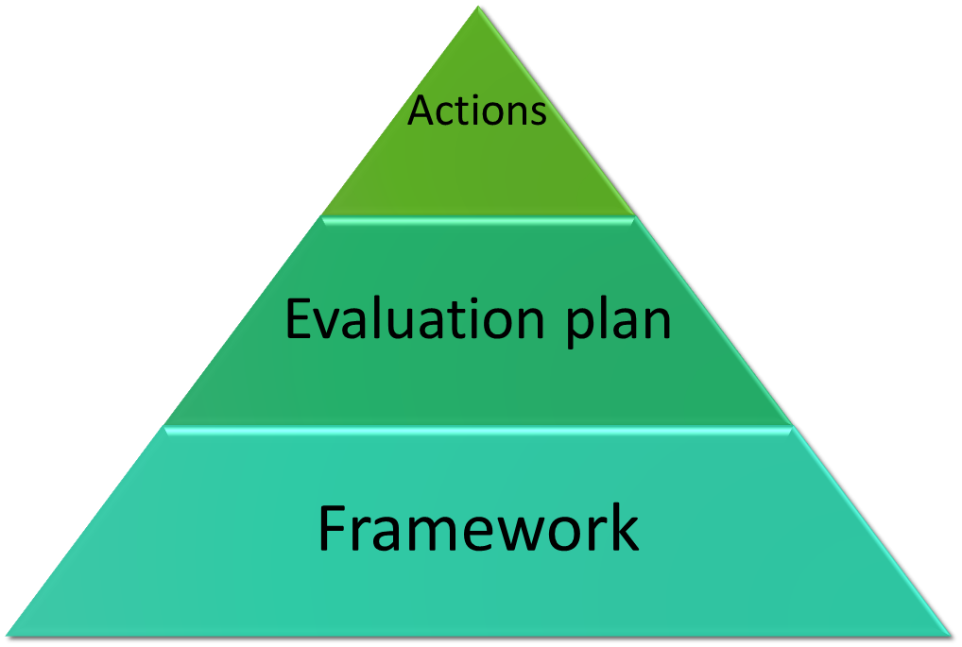
The project evaluation concerns analytically:

Slide 7
The framework
Framework for understanding program evaluation and facilitating integration of evaluation throughout the public health system has been produced.
The purposes of this framework (PFA WP3) has :
summarized the essential elements of program evaluation
provided a framework for conducting effective program evaluations
clarified the steps in program evaluation;
reviewed standards for effective program evaluation;
addressed misconceptions regarding the purposes and methods of program evaluation
provided indicators to be used in evaluation processes
provided a timetable for the evaluation process

Slide 8
The project evaluation plan is based:
Evaluation plan
Internal
Deliverables
External
Activities

Slide 9
A systematic monitoring aims at ensuring
a timely reporting of issues/criticalities in the process and implementation of appropriated measures;
production of the project outputs according to the planned activities;
production of the benefits described in the specific objectives;
sustainability of the JA during its execution.

Slide 10
The final evaluation of outcomes aims at ensuring
an evaluation of the possible impact provided by the actions implemented at the country and European level;
elaboration of the recommendations that will be produced at the end of the JA to help improving the programs and policies aiming to address HI in EU countries after the JA.

Slide 11
Deliverables linked to this WP
Monitoring & Evaluation framework (M4) √ ☺
Timetable of evaluation √ ☺
Intermediate report (M18)
  Internal
  External
Final evaluation report (M36)
  Internal
  External

Slide 12
Milestones to be reached by this WP
Framework available for partners on EC platform and Wrike (M4) √ ☺
A timetable for PFA for has been produced
(M5) √ ☺
Intermediate monitoring report available for partners on EC platform and specific websites (M18).
Final evaluation report available for partners on the EC platform and specific websites (M36)

Slide 13
Monitoring & Evaluation framework tasks
M & E framework
Continuous process monitoring
Continuous context monitoring
Continuous outcome monitoring
Intermediate and final evaluation

Slide 14
Monitoring & Evaluation framework (M4)
Task 3.2 Continuous process monitoring
This task consists in ensuring that project milestones and projects outputs are met in accordance with planned activities.
Periodic monitoring (realized in collaboration with WP1) will allow to check the compliance with the planned project activities, the appropriateness of expenditure and the quality of the staff involved in the project.
The possible causes of such discrepancies will be identified to take any appropriate corrective actions.

Slide 15
Monitoring & Evaluation framework (M4)
Task 3.3 Continuous outcome monitoring
This task consists in evaluating if planned activities generate the benefits described in the specific objectives of the JA.
Periodic monitoring (realized in collaboration with WP1) will allow to check the effectiveness of the activities implemented by partners

Slide 16
Monitoring & Evaluation framework (M4)
Task 3.4 Continuous context monitoring
This task consists in ensuring the sustainability of the project during its execution. The risks of the project failure will be concretely evaluated in relation to the hypotheses formulated in the risk analysis section.
Context monitoring will be an integral part of the periodic monitoring report and will be provided annually

Slide 17
Task 3.5 Intermediate and final evaluation (internal and external)
An intermediate and final internal and external evaluation will be carried out at months 18 and 36.
An intermediate report will contain evaluation of projects activities verifying any significant deviations from the work plan.
The external evaluations will be designed and implemented by an external and independent evaluation team, with a high level of expertise on European project evaluations.

Slide 18
Evaluation plan-first steps
Policy Framework Action in WP3 July 2018 √ ☺
Meetings with WP leaders – July 2018, July 2019 √ ☺
Framework and indicator list – September 2018 √ ☺
Activities to be evaluated- September 2019 √ ☺
Activities evaluation – October 2019 until end of 2020 under process
Internal evaluation (by WP3) M18 and M36
External evaluation- M18 and M36

Slide 19
Some evaluation first comments
All WPs are running according schedule √ ☺
Website https://jahee.iss.it/ √ ☺
Meetings in each WP are organised in time and most countries are participating (>80% participation in SKYPE meetings) √ ☺
Several SKYPE meetings have been organised √ ☺
Meetings of SC are organised in time and most countries are participating (>80% participation) √ ☺
In all WPs, most countries have submitted CA (except a few sporadic cases)
  √ ☺
Most countries have proposed activities to be implemented in JAHEE and several countries have started √ ☺

Slide 20
Evaluation total GANTT
 | 3 | 6 | 9 | 12 | 15 | 18 | 21 | 24 | 27 | 30 | 33 | 36
Framework/evaluation plan/indicators
Website evaluation
Questionnaires/surveys
Countries assessment
External Expert Committee
Report on activities implemented
Evaluation Reports |  |  |  | * |  |  |  | * |  |  |  | *

Slide 21

Thank you

