Slide 1
Joint Action Health Equity Europe (JAHEE) - WP 9 Health Equity in All Policies
National School of Public Health, Management and Professional Development – Bucharest ROMANIA
Implementation Actions – ROMANIA
“Assessing the impact of community centers on the vulnerable population: A case study in 10 counties in central and western Romania”
NSPHMPD:
Dr. Adina GEANA
Dr. Mona MOLDOVAN
Dr. Silvia Gabriela SCÎNTEE

Slide 2
National School of Public Health, Management and Professional Development – Bucharest ROMANIA
AIM: to convince the policy makers about the importance of the impact of 24 community centers on mitigating urban-rural differences in healthcare quality and access to socio-medical services is
TARGET: identify areas of most needed intervention in the community centers to improve the social inclusion and provide necessary support for vulnerable populations with special needs.

Slide 3
Why these community centers?
National School of Public Health, Management and Professional Development – Bucharest ROMANIA
2012 - NSPHMPD implemented occupational standard for community nurses in Romania & established 24 community centers to provide care for vulnerable populations in rural areas:
Poor people, with low socio-economic status
Elderly people living alone / Young mothers with many children
People suffering from addictions /People w/ progressive degenerative disease
Roma people in high risk situations etc
These people—often neglected and at high risk for social exclusion—need functional, responsive community centers
After seven years, evaluate impact & function of these community centers

Slide 4
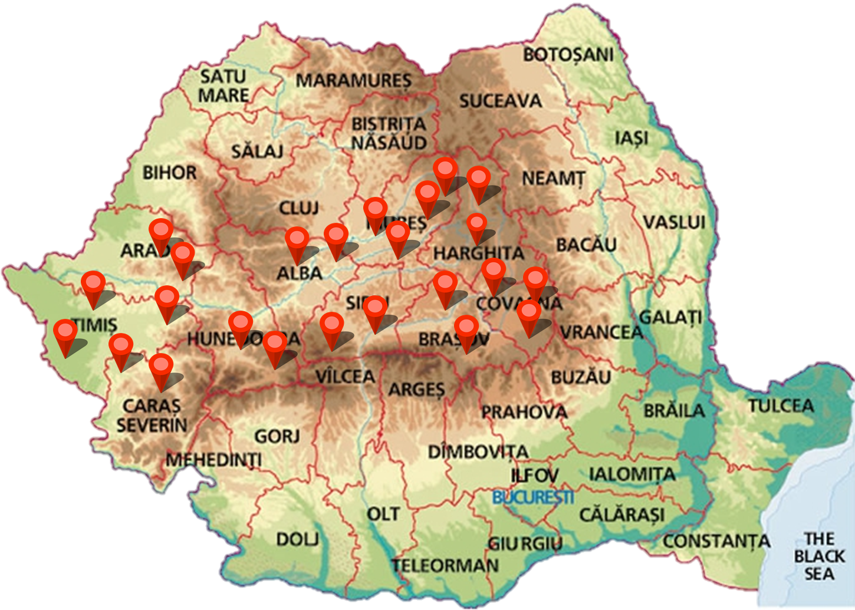
Implementation: Regional Level
National School of Public Health, Management and Professional Development – Bucharest ROMANIA
The 24 community centers were set up in 10 counties across central and western Romania.
Western Romania – 9 centers
TIMIȘ County: 3 centers
ARAD County: 2 centers
CARAȘ SEVERIN County:2 centers
HUNEDOARA County:2 centers
Central Romania – 15 centers
BRAȘOV County: 2 centers
MUREȘ County: 4 centers
ALBA County: 2 centers
COVASNA County: 3 centers
HARGHITA County: 2 centers
SIBIU County: 2 centers

Slide 5
Our main challenge
National School of Public Health, Management and Professional Development – Bucharest ROMANIA
Willingness of the local public and health authorities to communicate & cooperate in order to identify and take responsibility for existing issues, and devise a common plan to resolve them
Potential issues:
Lack of knowledge about community centers
Lack of access to community centers
Lack of adequate personnel training in community centers
Lack of proper community integration of centers
Lack of proper public budgets allocated to centers, and proper safety and care measures

Slide 6
Our Implementation actions (IA)
National School of Public Health, Management and Professional Development – Bucharest ROMANIA
Surveying the community nurses from the 24 community centers (NSPHMPD) – ongoing
Surveying the Local Public Authorities (mayors) from the 24 community centers (NSPHMPD) – ongoing
Analyzing the data collected from periodic reports and survey questionnaires (NSPHMPD) – initiated
Identifying the intervention areas (NSPHMPD) – planned 2020
Proposing the needed interventions to the Ministry of Health and to the Ministry of Regional Development and Public Administration (NSPHMPD) – planned 2020

Slide 7
Indicators for assessing the effectiveness of the IAs
National School of Public Health, Management and Professional Development – Bucharest ROMANIA
Reduce absolute numbers and rates of:
Elderly living alone
Young pregnant single women
Alcohol addicts
Drug addicts
Increase absolute numbers and rates of:
Roma people registered on the list of a family doctor
Persons receiving medical advice from community center

Slide 8
Expected outcomes
National School of Public Health, Management and Professional Development – Bucharest ROMANIA
Highlighting best practices in the community centers
Sharing the results between the 10 involved counties in order to implement the best practice
Expanding program by determining other counties to join

Slide 9
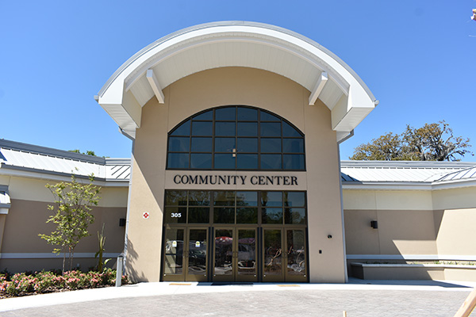
THANK YOU!
National School of Public Health, Management and Professional Development – Bucharest ROMANIA
ageana@snspms.ro
WP9 Implementation actions - ROMANIA

